Slide 1
Welcome! Virtual Town Hall Meeting
President, Julianna barnes, ed.d.
April 24, 2020
Thank you for joining us. The meeting will begin shortly
Your devices have been muted.
Notes:
Thank you for joining our second Town Hall meeting for our Cuyamaca College community
My name is Julianna Barnes, the proud president of Cuyamaca and I’m delighted to see so many of you today

Slide 2
Town Hall Format
Host: Julianna Barnes, President
Moderator: Christianne Penunuri, Director, College & Community Relations
Technical Facilitator: Valeri Wilson, Executive Assistant
This Town Hall is being recorded, with closed captioning, and will be posted to the Cuyamaca College website
Interpreting services for today are provided by Andrea Rehkopf. Pinning her video would ensure she remains on your screen during the meeting.
Your devices have been muted given the large number of participants
Please use the “Chat” feature (Public only) to share thoughts and ask questions
The Host & Moderator will stop to respond to questions periodically throughout the session
Notes:
Today’s format…
The moderator and I looked through the many questions submitted with the RSVPs and identified some “themes”… I will address as many of these throughout the meeting today…

Slide 3
Today’s topics
Thriving in our Virtual College
Planning for the Eventual/Gradual Reopening of Campus
Fall 2020?
Planning for a Budget Shortfall
Q & A (Sprinkled throughout)
Notes:
Today’s topics (run through)
Illuminate- “Thriving”
Appreciation for all… EVERYONE has stepped up to make this transition happen… across divisions… across departments… across constituent groups… including our hourly employees… including our part-time faculty. We have the best team at Cuyamaca and I couldn’t be more proud.
Point out “Eventual/Gradual”
Point out “Shortfall”… there will be very difficult decisions ahead… we cannot escape the inevitable recession… we are resilient, though…

Slide 4
Checking in
USING THE CHAT ROOM,
SHARE ONE WORD OR PHRASE
DESCRIBING HOW YOU’RE FEELING RIGHT NOW
Notes:
Range of feelings… and they are all normal right now… (fear, anxiety, grateful, etc..)

Slide 5
Freedom vs. covid-19
Notes:
Health care workers in Colorado clashed with protesters who demonstrated on Sunday to demand an end to the state’s stay-at-home order.
We are anxious to get back to our regular lives, we want to have our social lives, we want to visit friends, we want to go to the beach, we want to go to work… but the reality of the pandemic is such… if we move too quickly, we risk spreading the virus…

Slide 6
Notes:
The health and economic crisis have generated a range of emotions that
More attention to the emotional mental health of our students

Slide 7
Employee Assistance Program (EAP)
VEBA has arranged to provide confidential EAP services to you and your family members. The EAP can help with life issues through a wide range of services, including face-to-face counseling sessions or a referral to community resources.
Program (EAP) The EAP is available 24 hours a day, seven days a week, 365 days a year. Phone: 888-625-4809 Web: www.liveandworkwell.com access code:veba
Notes:
And keep in mind we have support for employees… some of you have reached out and shared that you have used this service… it is there for you, so please use it…

Slide 8
Thriving in our virtual college
Instruction
Student Support Services
Operations
Governance
Professional Development
Strategic Priorities
Student Success & Equity
Notes:
From the Great Shift to the New Normal…
We are beginning to settle in to our Virtual College…
Still working out issues… but generally getting the groove in each of these areas listed
About this zoom snapshot….

Slide 9
Student equity considerations
Low income, communities of color are disproportionately impacted
More lay offs
Higher rates of infection
Disproportionately impacted (DI) students are in need of technology and connectivity
DI students’ basic needs are heightened (e.g. food insecurities)
Formally “non-needy” students have found themselves to be in need
Undocumented students have been shut out of government support (e.g. CARES Act)
Notes:
*With much of the American economy shut down, job losses have hit some parts of the population harder than others. African-American and Hispanic people and people in low-income households are more likely to have been laid off than others, according to a recent Pew Research Center survey.
*Those groups have also had higher rates of infection and death from Covid-19. In New York City, black and Latino people are dying at twice the rate of white non-Hispanics, and low-income neighborhoods have seen the largest case counts. Many of them are “essential” employees in the front lines- working in restaurants, delivering food, working in nursing homes, driving buses, cleaning offices… our gratitude goes out to them…
EMTLI; Collaboration happening with 3 of our faculty coordinators of equity, DE and professional development (Moriah, Jodi, and Donna)

Slide 10
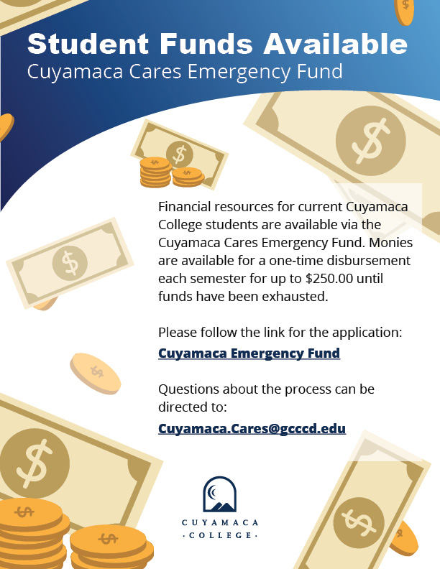
Emergency grants
Cuyamaca College Emergency Fund:
Emergency Fund application is available online
$250 $500 per student
$1.4 million in CARES Act (resident students/Title IV eligible)
Promise Basic Needs Grants:
Promise Scholars who receive the CCPG grant (former BOG)
$250 $500 basic needs grants
Undocumented Students:
$500 per student (leverage GCCC Foundation funds, Promise, & Equity)
Notes:
Equity very much on our minds for our most vulnerable students and newly impacted; Disproptionately impacted; those with tech needs, basic needs, counseling needs
Emergency Grant- $100K
Promise Grants- $78K
Include INFO re: undocumented Students, SD Foundation (point out short period of time)
State monies went in 2 hours

Slide 11
Addressing needs
Computers & Connectivity
Leveraging monies from the San Diego Foundation and the Grossmont Cuyamaca Community College Foundation, laptops and connectivity being explored for students
WiFi not currently available in the campus parking lots (currently a summer 2020 project); exploring this option in the future
Employee distribution of laptops and/or VPN access- exploring expansion
Access to Campus
Current: Limited access to essential needs; request through Dean or VP
Future: Coordinated effort being planned to increase access (aligned with lifting of stay-at-home order)

Slide 12
Q&A -
Moderator Christianne will read some of the questions from the chat room
Notes:
Questions on the horizon?

Slide 13
Planning for reopening campus
RAPID RESPONSE PLANNING TEAMS- DISTRICTWIDE
FACILITIES
TECHNOLOGY
INSTRUCTION
STUDENT SERVICES
HUMAN RESOURCES
Notes:
When will we return?
Social and physical distancing will be with us
Disinfecting and cleaning implications
Masks?
Will we go online? Hybrid? Face to Face? With instruction and student services
Phase 1: A partial return to campus for some essential employees, with limited access to classrooms and offices, required physical distancing, required personal protective equipment, and strict sanitation and hygienic requirements.
Phase 2: A full return to campus, but with continued limitations including physical distancing, some required personal protective equipment, no group gatherings, and continued strict sanitation and hygienic procedures.
Phase 3: A complete return to operations once testing and/or a vaccine is widely available. More automated processes will be offered where feasible, along with more online and remote delivery of courses and services. We will continue to follow strict sanitation and hygienic procedures.
The teams will be reporting out at the District Executive Council (comprised of governance and labor leaders) weekly Emergency Planning meetings for follow up and execution of recommendations, as appropriate.

Slide 14
Fall 2020: ambiguity
Considerations due to the pandemic:
Shelter in Place status
Limitations for small or large gatherings
Social/Physical Distancing requirements
Positive cases and exposures
Limitations for vulnerable populations (65+, compromised health)
Possible Term Interruption

Slide 15
Fall 2020: Resilience
Here’s what we do know:
Our communities and students need us
Our staff, faculty and students are resilient
We will do our best to serve students
Notes:
How do we leverage our resiliency to make decisions in the midst of chaos and ambiguity?

Slide 16
Possible fall schedule 2020 scenarios
Approach A:
Traditional schedule- decide to transition to DE late summer as conditions and timing allow
Approach B:
Schedule most classes via DE but allow flexibility for a limited number of courses to transition to face-to-face as conditions and timing allow
Approach C:
Decide now to offer all courses in a DE mode
Source: ASCCC Planning for Fall 2020
Notes:
There is no perfect plan in the changing world of COVID-19
Any plan will be subject to second guessing
How to best serve students in this unique situation while balancing needs of staff and faculty?
What does this mean for student services? What does this mean for operations? We have offices in close proximity to one another… we cannot cram students in small waiting rooms? Do we have as the first phase all students remain off campus, but employees can come back with social distancing, masks, being mindful of vulnerable populations (65+, compromised health, etc..)

Slide 17
A Dialogue about Reopening Campus The Cuyamaca College Council (CCC) invites you to participate in a dialogue about the eventual and gradual reopening of our campus. While the date of our reopening is not yet known, Governor Newsom recently announced a phased framework to eventually reopen California, prompting us into action. Please join us to learn about current college and districtwide efforts to plan for our reopening. We welcome your questions, thoughts and suggestions. Tuesday, April 28 3:30–5:00 p.m. Please register here by noon on Monday, April 27 to receive the Zoom information. Contact valeri.wilson@gcccd.edu with any questions.
Notes:
CCC will feed discussion into DEC and rapid response teams

Slide 18
Q&A -
Moderator Christianne will read some of the questions from the chat room
Notes:
Questions on the horizon?

Slide 19
budget
California is "now in a pandemic-induced recession," Gov. Gavin Newsom

Slide 20
Budget: implications for gcccd
GCCCD District Estimated Deficit*
19-20 $1.8 million
20-21 $14.8 million
*This is if we take no action to reduce expenditures
Current/Future Considerations
Schedule reductions,-Smr, Fall, and Spr
Release of some hourly employees without work duties (all work-study will remain employed through June 1)
Freezing of most approved strategic hires
Districtwide efficiencies (e.g. public safety, technology)
Continued discussions at college and district governance committees/councils
Notes:
What we know now is that the state reduced (deficit) our 2019-2020 budget by $4.3 million in late February. At the time, we were confident the deficit would be eliminated by June, but then COVID-19 hit the state. We are now in the process of reducing our current operating budget by $4.3 million. Absent specific budget information from the state, the district is tentatively planning for a 5% reduction in the 2020-2021 budget, with a contingency for an additional 5% reduction in September. The Chancellor’s Cabinet is examining all expenses to see what can be contained and reduced now so we can avoid catastrophic decisions in the future.
This isn’t easy…
I was a part-time employee in college and used 3 part time jobs to pay the bills
We know that schedule reductions means potential reductions in our part-time faculty workload… These are members of our community who we value…who have given of their lives to serve our students… we don’t want to be in this position, but we are;
Pat had some preliminary discussions with ILAT about this…
We will continue to discuss

Slide 21
Budget forum
The Resource Operations Council (ROC) invites you to join them for a discussion about the district and college budget, with special guest, Sahar Abushaban, Interim Vice Chancellor, Business Services. Come learn about the current state of the budget and current planning efforts underway. Time will be allotted for Q & A.
Wednesday, may 6
9:30 a.m. – 10:30 a.m.
RSVP, by using this link for the Budget Forum by providing your contact information and submitting any questions, suggestions or thoughts you have in advance. Sahar Abushaban and Nicole Salgado will address as many of them as possible during the meeting.
Zoom login information will be emailed to all those who RSVP by 7:30 a.m. on May 6. For additional information, please contact Laci Diaz at laci.diaz@gcccd.edu.

Slide 22
Q&A -
Moderator Christianne will read some of the questions from the chat room
Notes:
Questions on the horizon?

Slide 23
Virtual Hall Chats

Slide 24
A Dialogue about Reopening Campus The Cuyamaca College Council (CCC) invites you to participate in a dialogue about the eventual and gradual reopening of our campus. While the date of our reopening is not yet known, Governor Newsom recently announced a phased framework to eventually reopen California, prompting us into action. Please join us to learn about current college and districtwide efforts to plan for our reopening. We welcome your questions, thoughts and suggestions. Tuesday, April 28 3:30–5:00 p.m. Please register here by noon on Monday, April 27 to receive the Zoom information. Contact valeri.wilson@gcccd.edu with any questions.

Slide 25
Budget forum
The Resource Operations Council (ROC) invites you to join them for a discussion about the district and college budget, with special guest, Sahar Abushaban, Interim Vice Chancellor, Business Services. Come learn about the current state of the budget and current planning efforts underway. Time will be allotted for Q & A.
Wednesday, may 6
9:30 a.m. – 10:30 a.m.
RSVP, by using this link for the Budget Forum by providing your contact information and submitting any questions, suggestions or thoughts you have in advance. Sahar Abushaban and Nicole Salgado will address as many of them as possible during the meeting.
Zoom login information will be emailed to all those who RSVP by 7:30 a.m. on May 6. For additional information, please contact Laci Diaz at laci.diaz@gcccd.edu.

Slide 26
Closing
Thank you for joining us today.
Notes:
Thank you Cuyamaca for all you continue to do…for supporting one another and our students
As we always have done, we will weather this storm, and we will do this together.
As we start to plan for what’s ahead, please lean on one another and reach out to one another.
Be good to yourselves and stay well and healthy, Cuyamaca.
Thank you

