Slide 1
Peter Utgaard, Ph.D.
Sabbatical report for Cuyamaca College Academic Senate

Slide 2
Thank you!
Academic Senate
AFT Local 1931
GCCCD Board

Slide 3
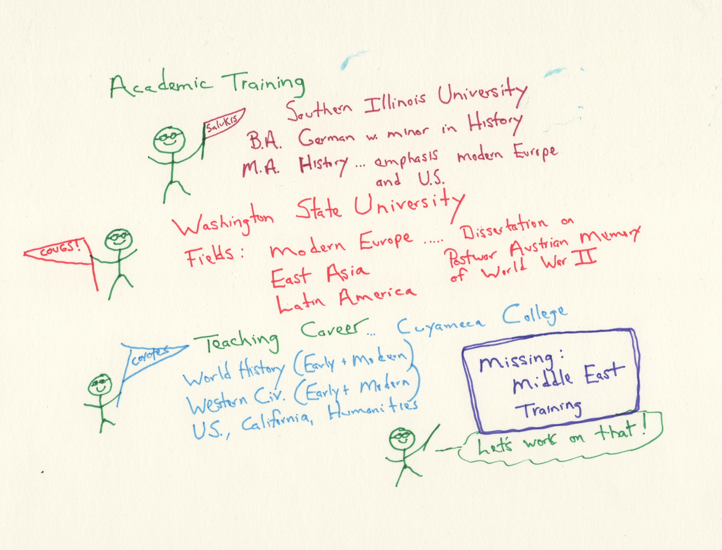

Slide 4
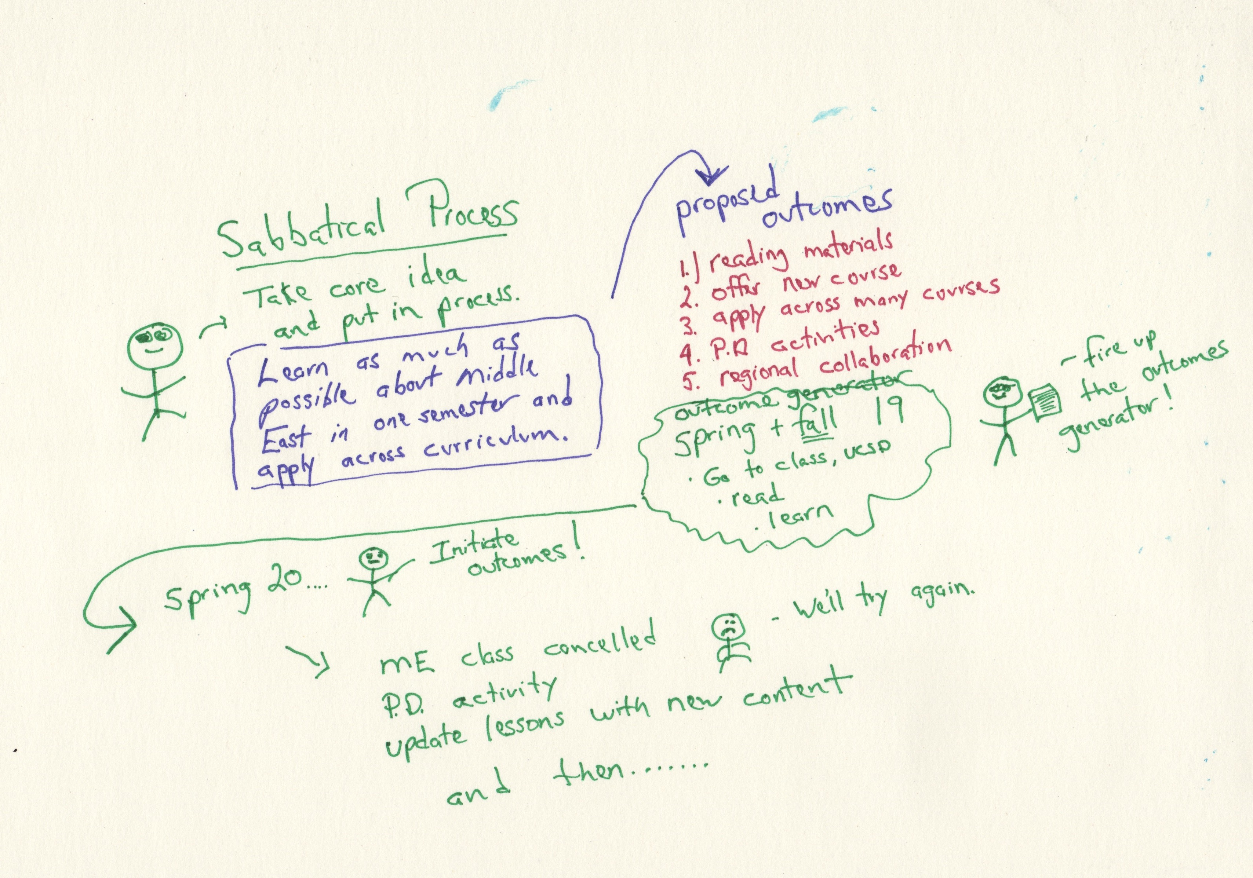

Slide 5
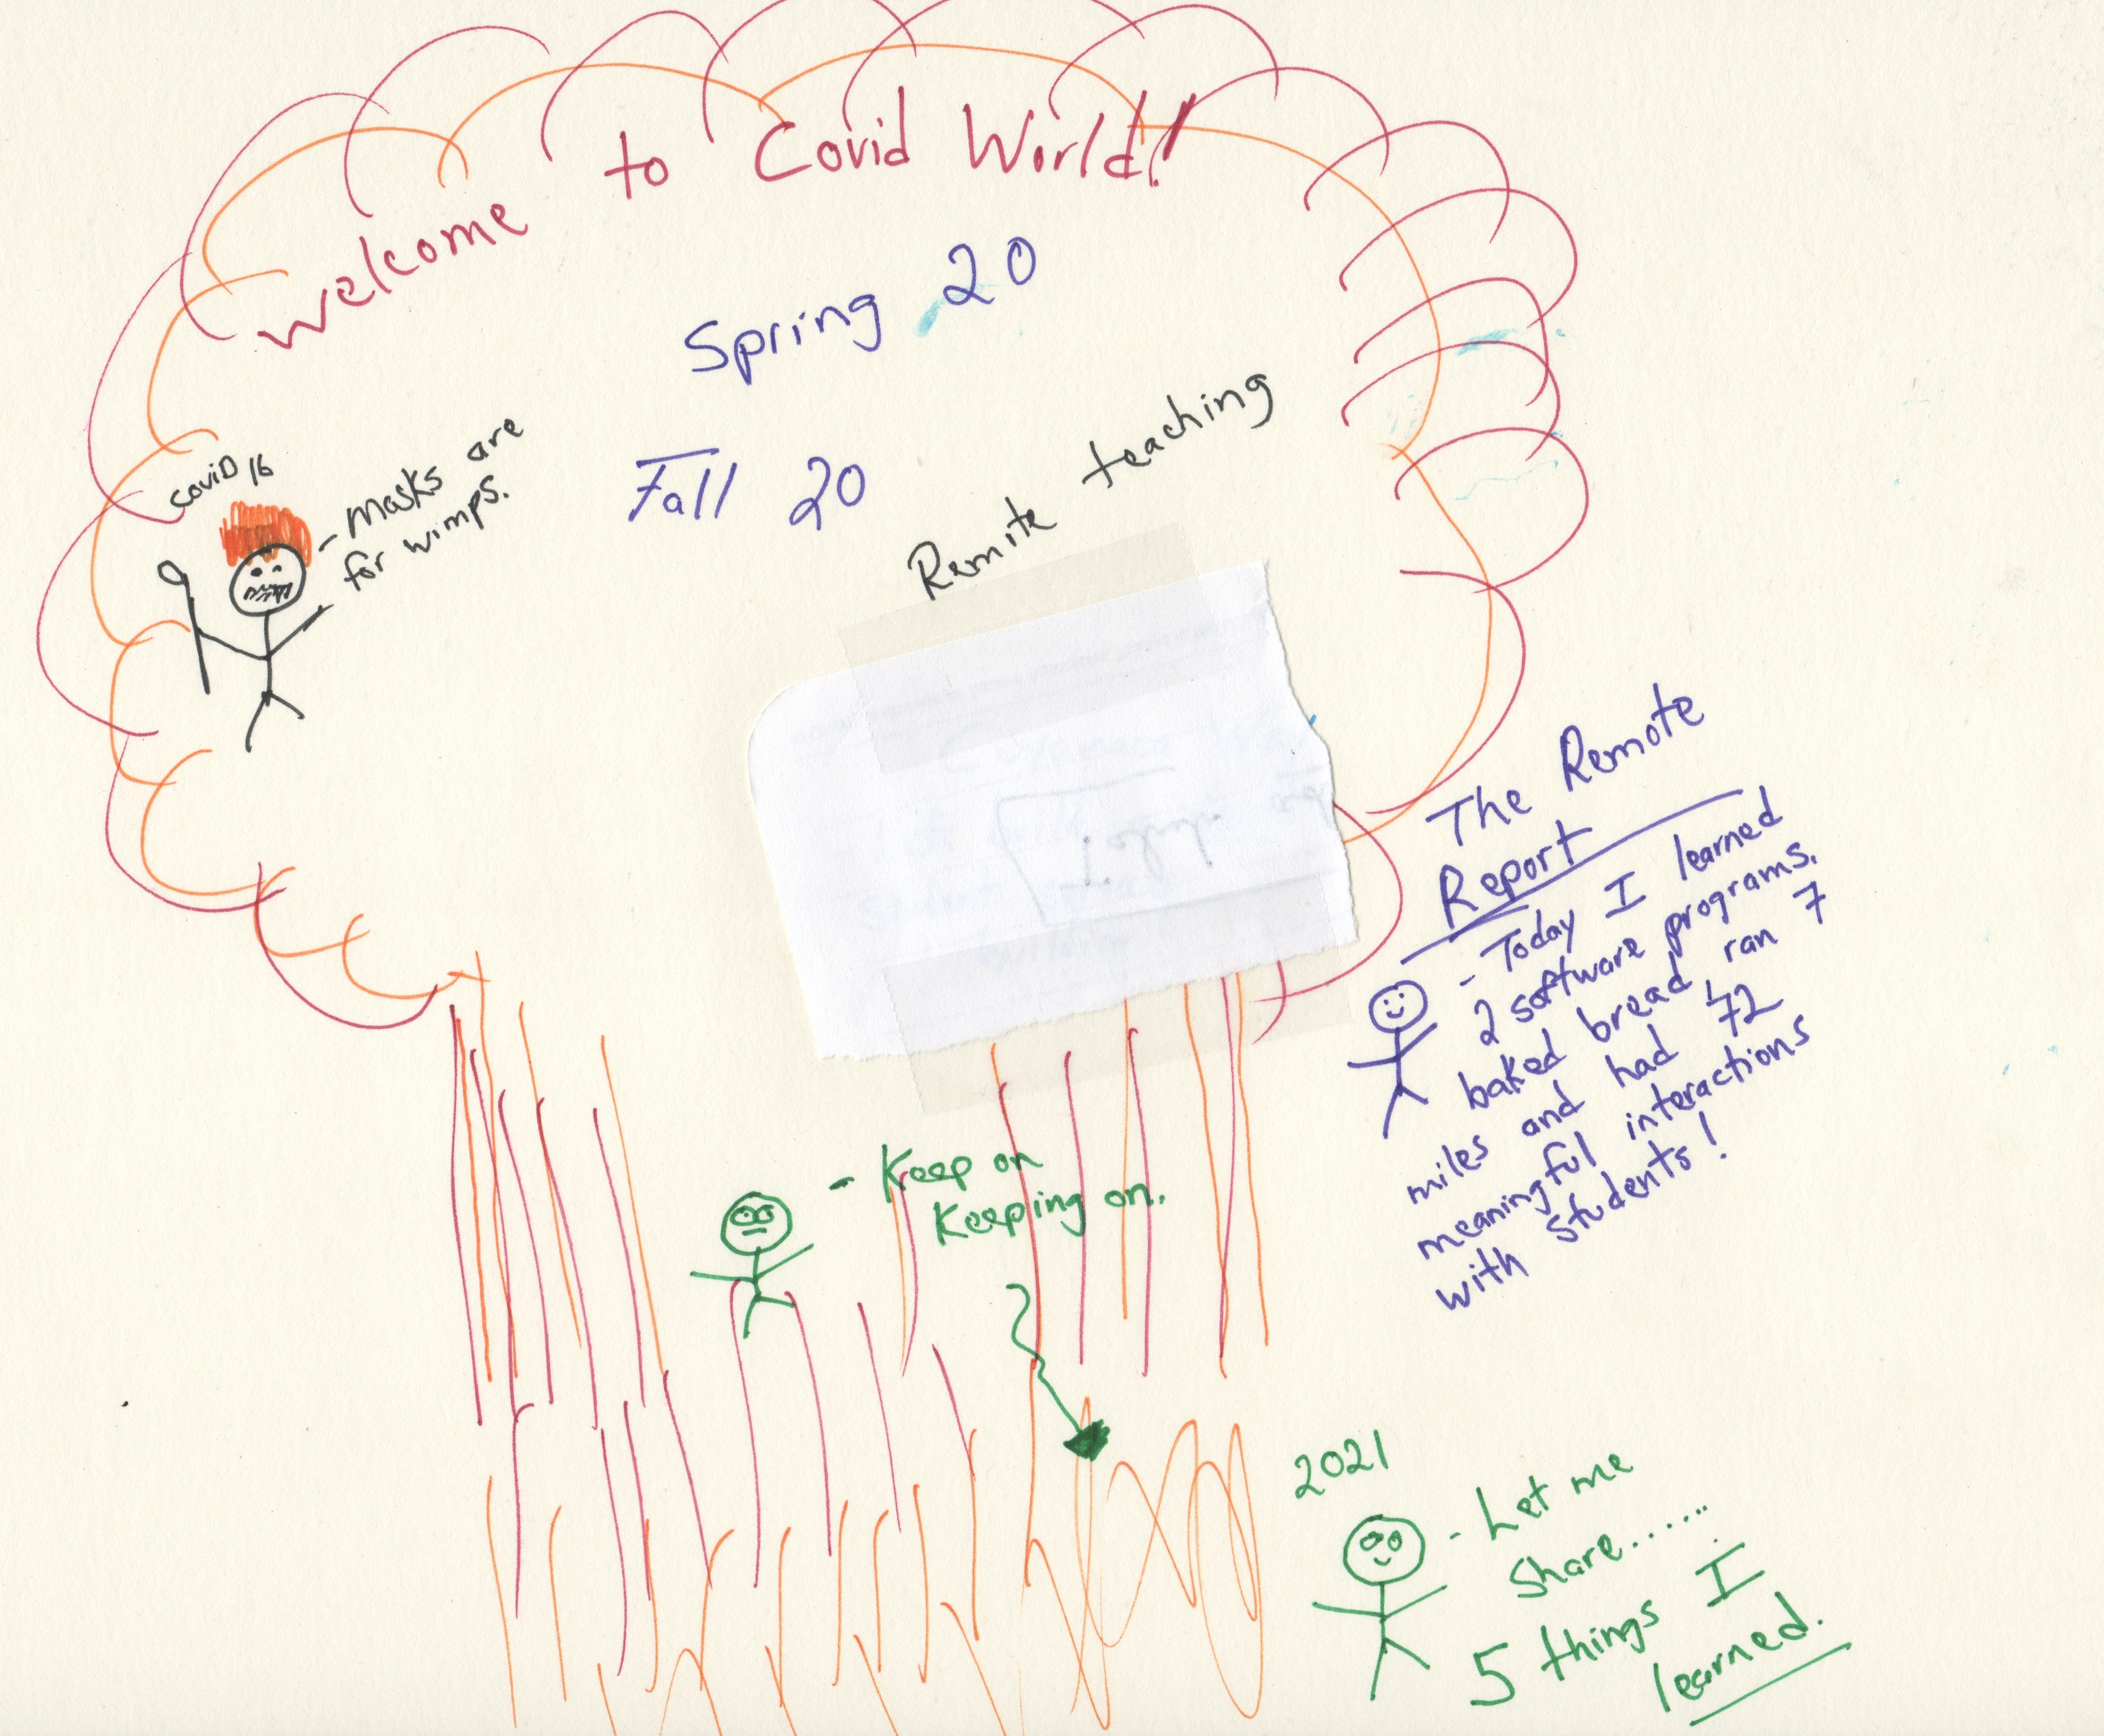

Slide 6
Ottomans (not Turks)

Slide 7
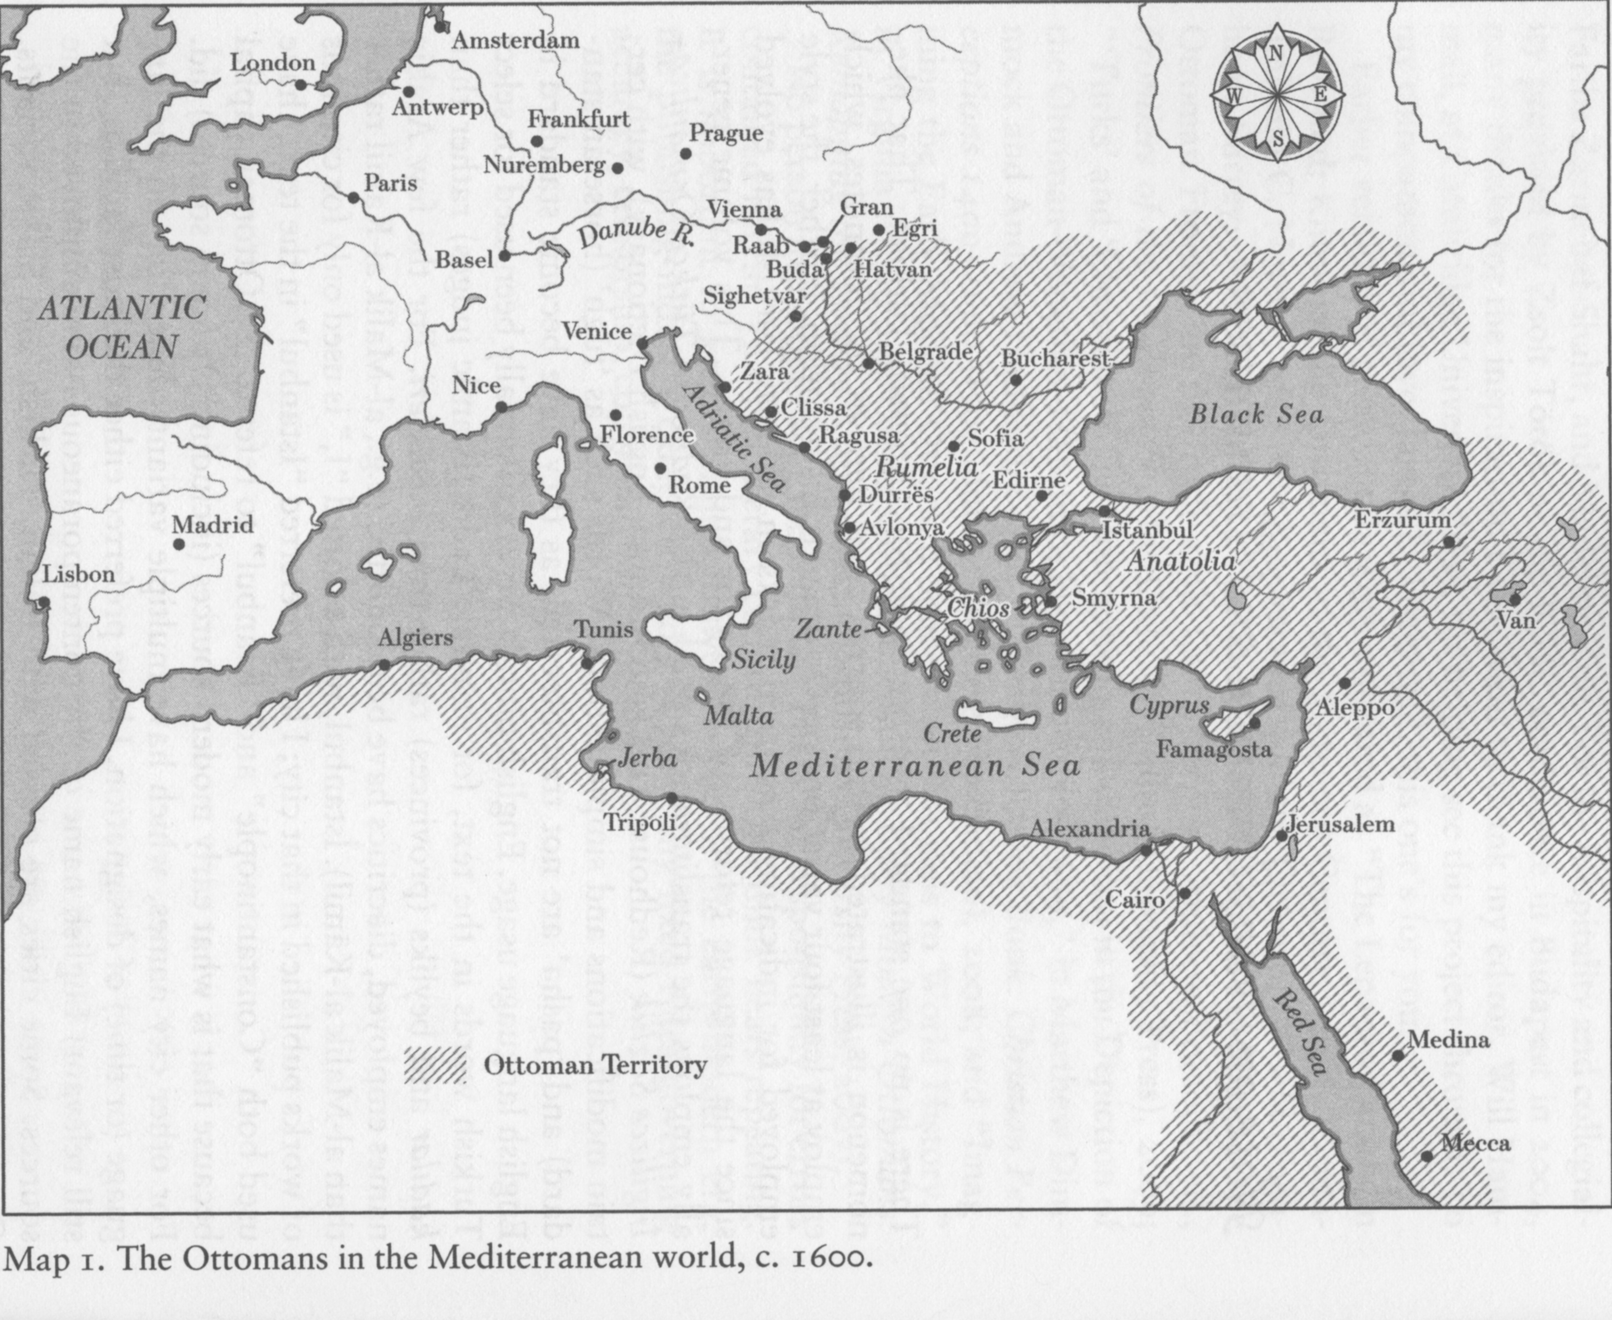

Slide 8
Oil matters, but in complicated ways
Anglo-Persian oil (early 20th cent.)
US involvement is key in post-WWII period….European recovery, global economy
1970s producers take control (oil crisis in West = oil boom for producers), US becomes net-importer until around 2010

Slide 10
Israel-Palestine conflict: not ancient, real-estate over religion

Slide 11
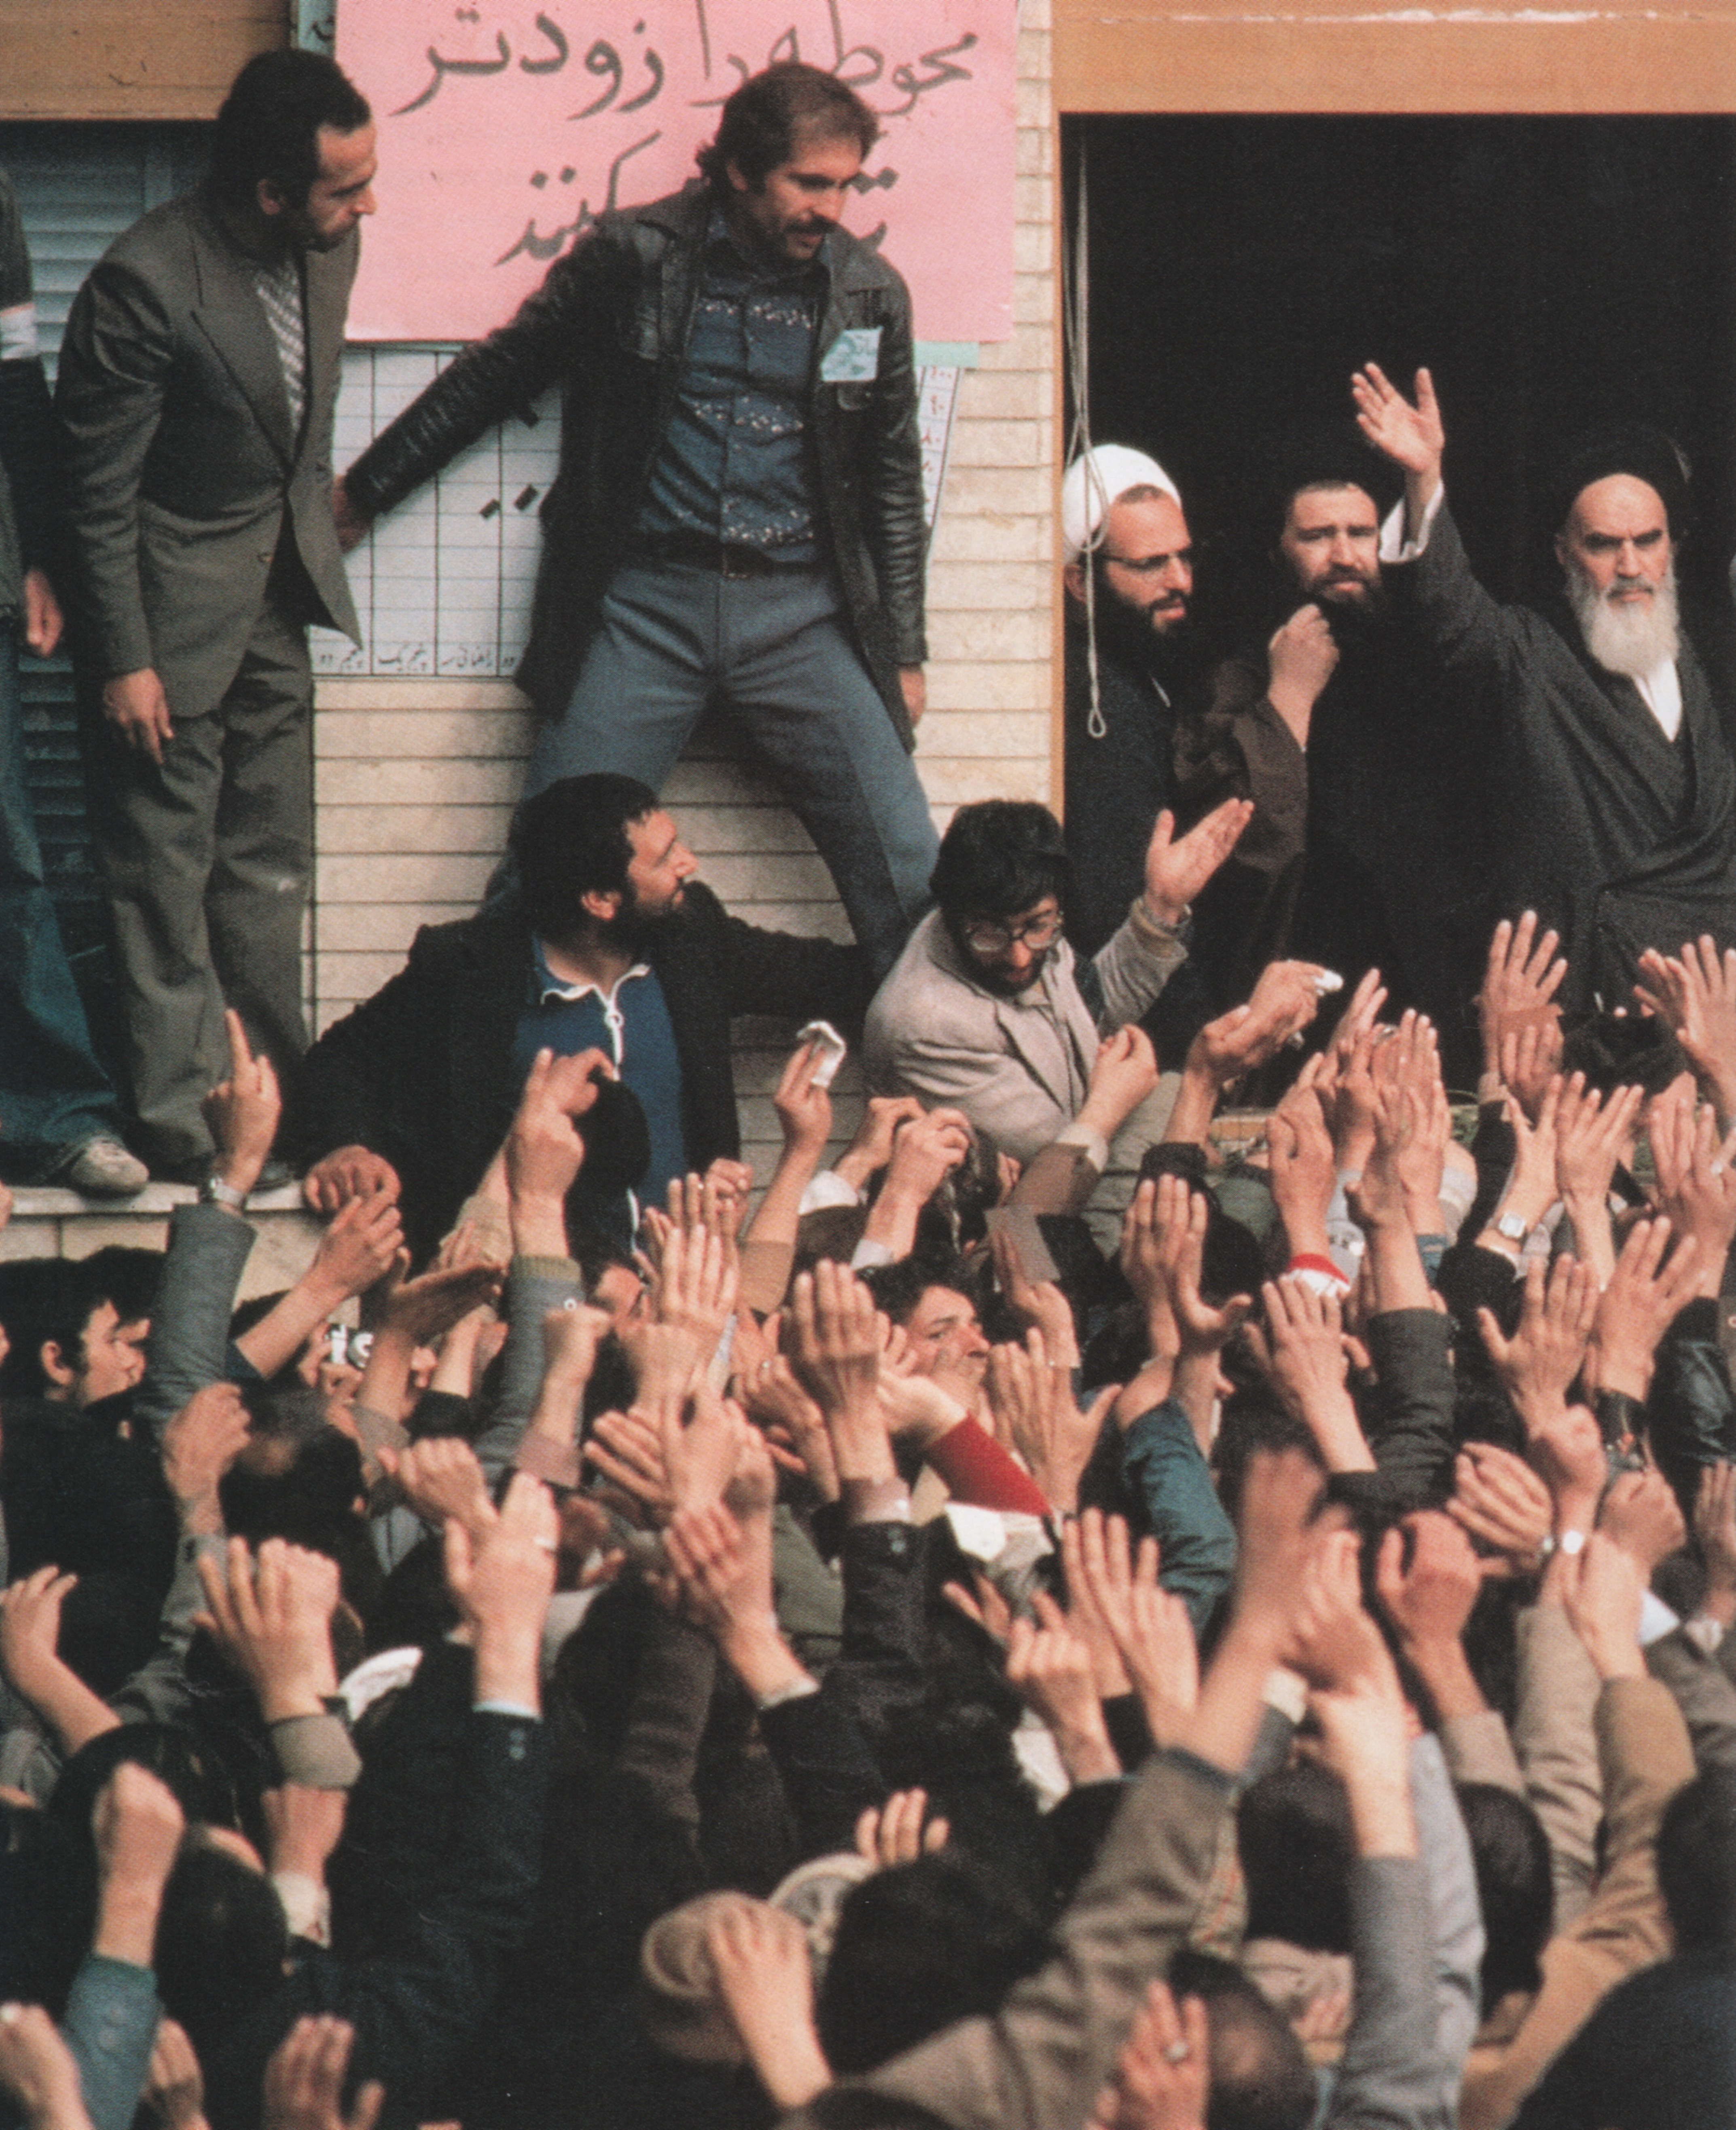

Slide 12
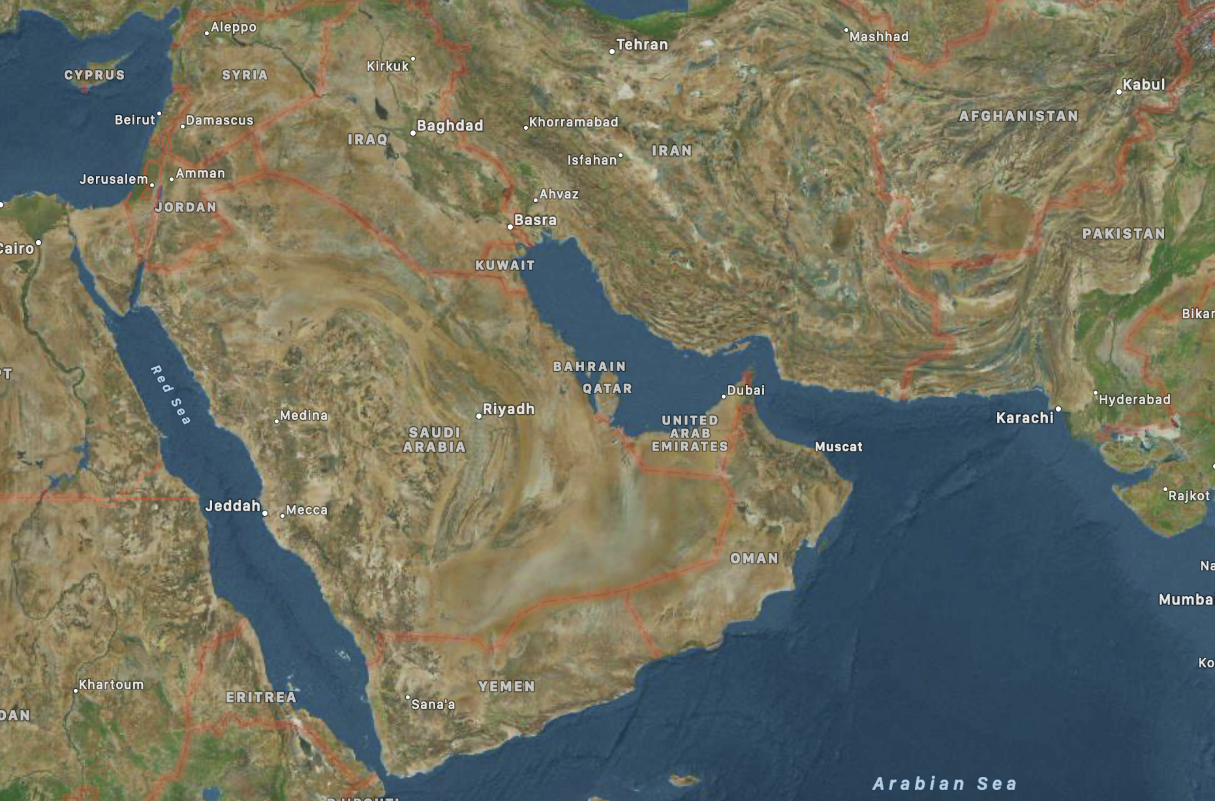

Slide 13
What is expected at UC San Diego? (aka transfer skills)
Reading full-length books
Incorporating outside reading into writing assessments (in and out of class)
High stakes exams and papers
Our students need to be prepared for this world.

