Slide 1
Working with Cuyamaca’s Middle Eastern Students
By Asma Yassi
CalWORKs Coordinator and Counselor
Cuyamaca College-Spring 2021

Slide 2
Location

Slide 3
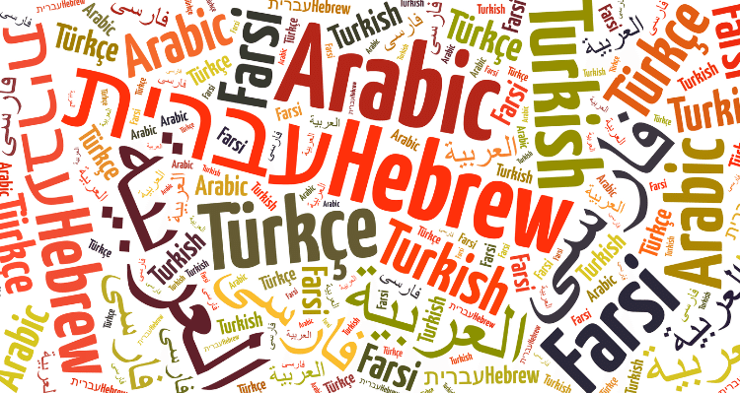
Languages and Dialects

Slide 4
Ethnicities and Religions
Arabs - Armenians - Assyrians Chaldeans – Kurds - Mandeans - Turkman – Yazidiz - Copts – Druze
And others minorities
Main religion is Islam followed by Christianity, Judaism, and many other.

Slide 5
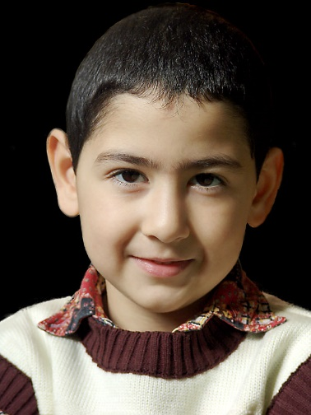
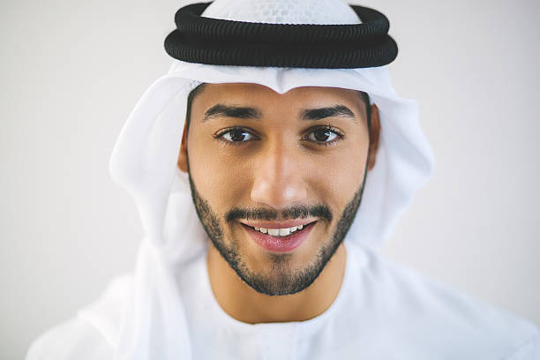
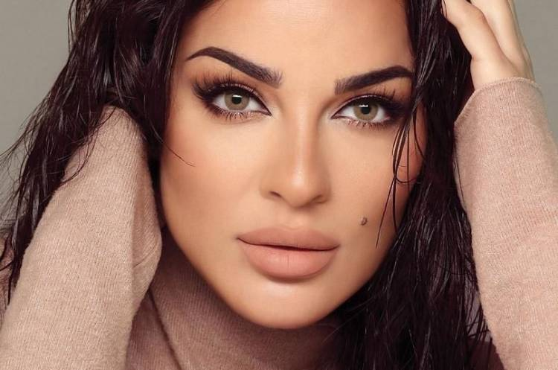
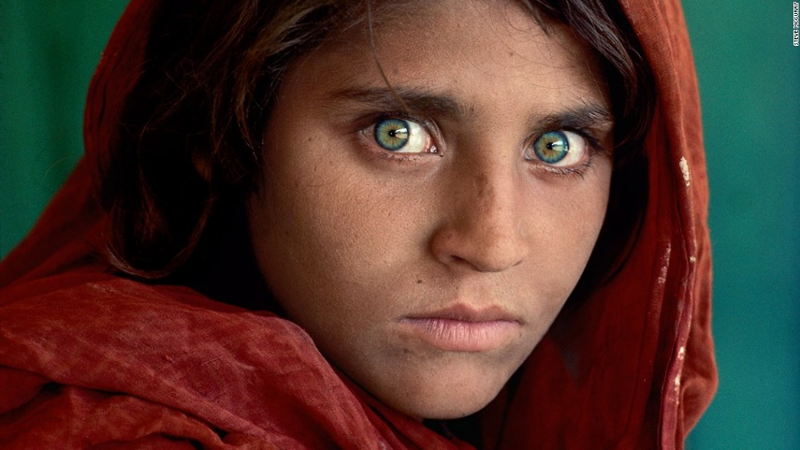
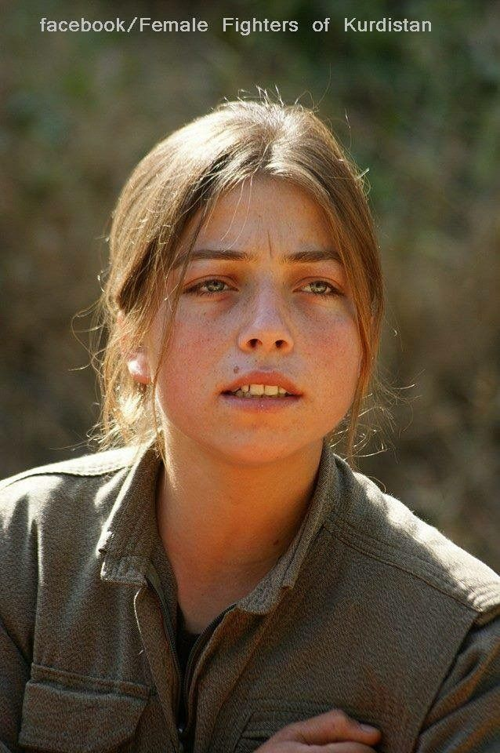
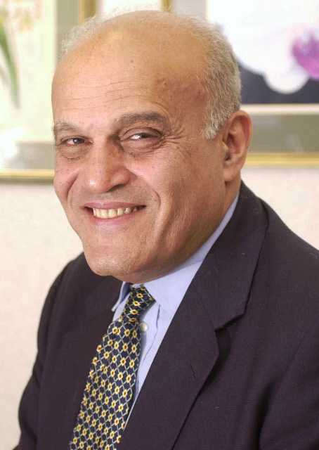
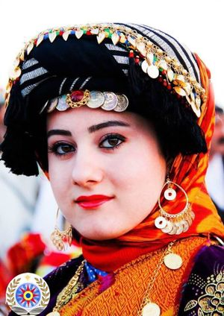
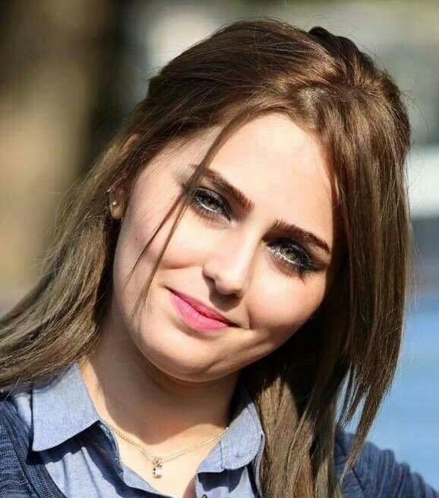
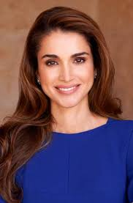
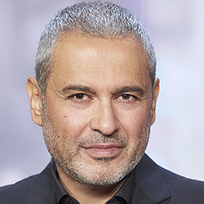
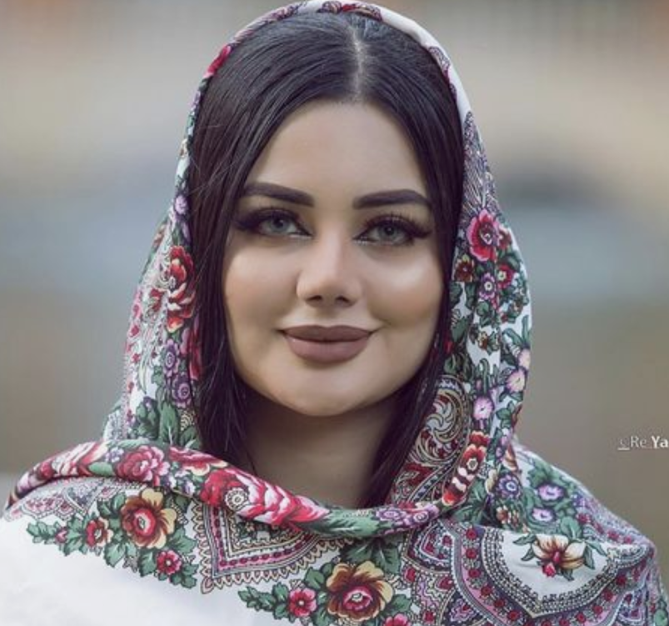
Physical Appearance

Slide 6
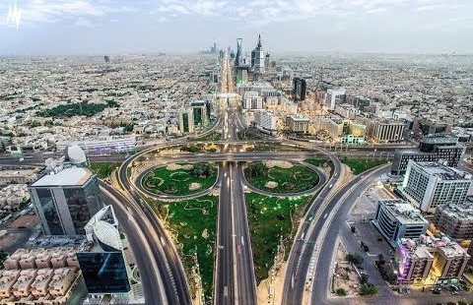
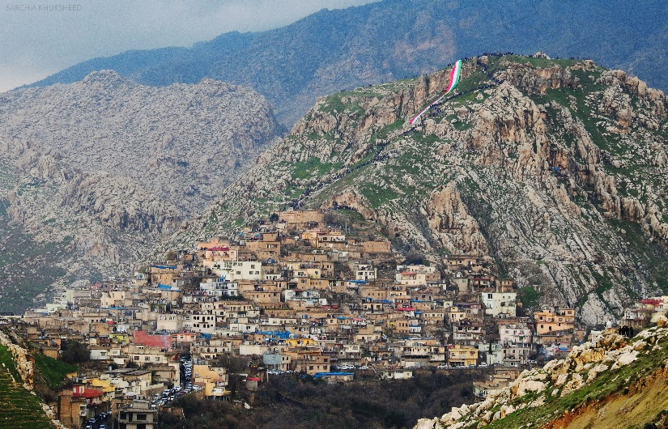
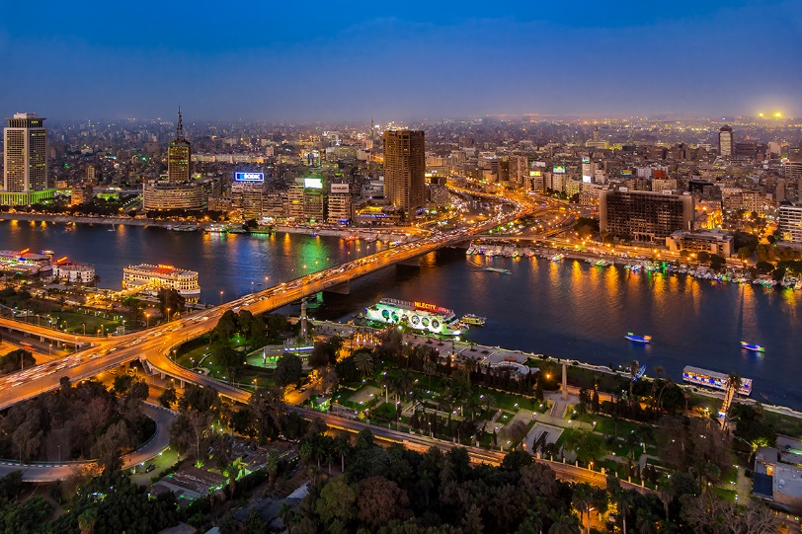
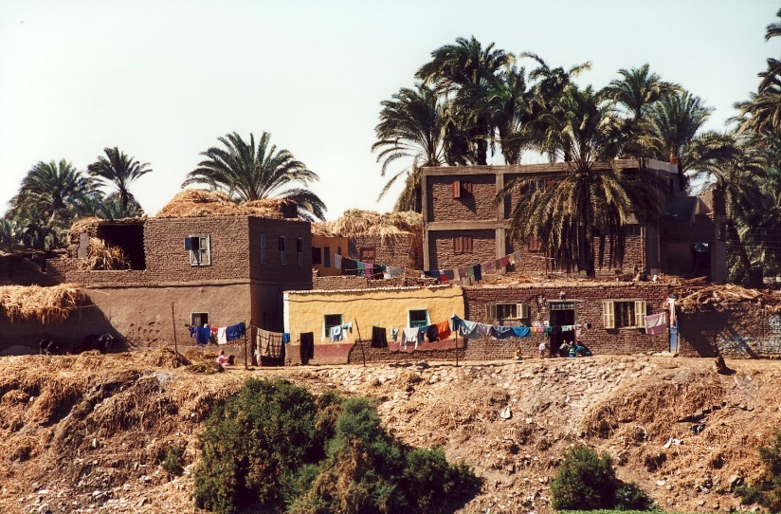
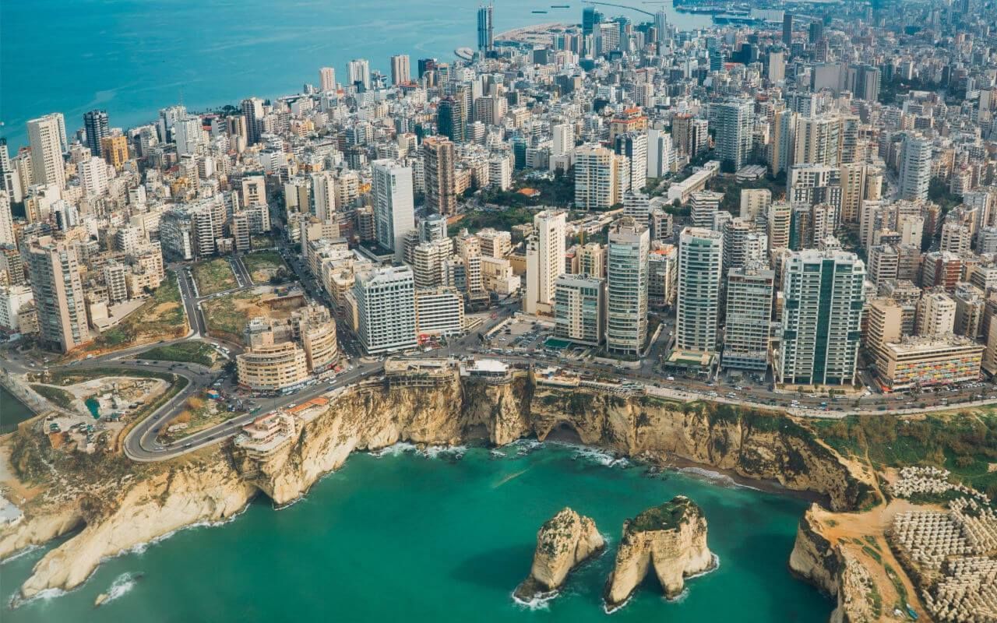
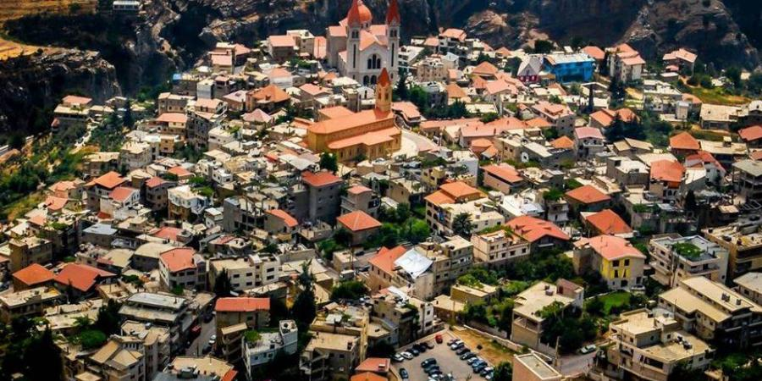
City Life vs. Village Life
Iraq
Egypt
Lebanon

Slide 7
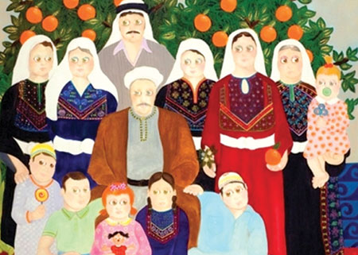
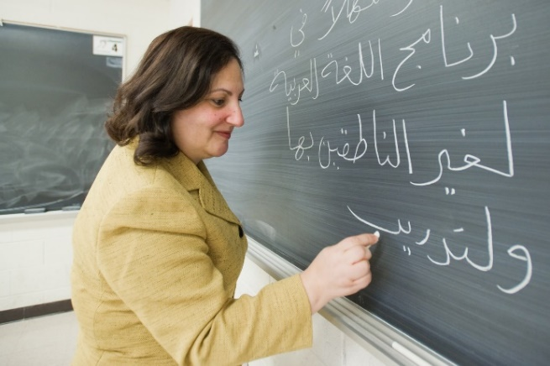
Middle Eastern Family and Gender Roles
Family- Centered Culture
Collectivist Society

Slide 8
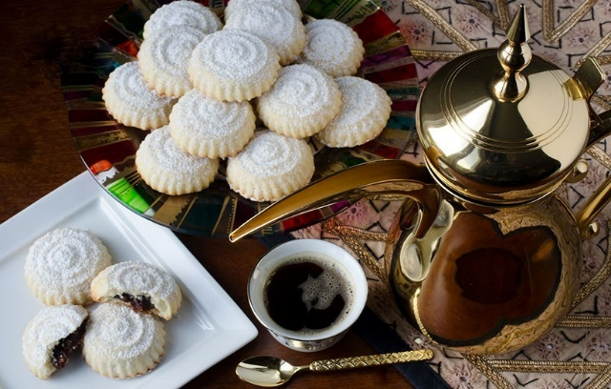
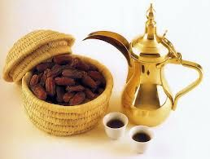
The Concept of Fate
Generosity and Hospitality
Lack of Privacy and Friendships

Slide 9
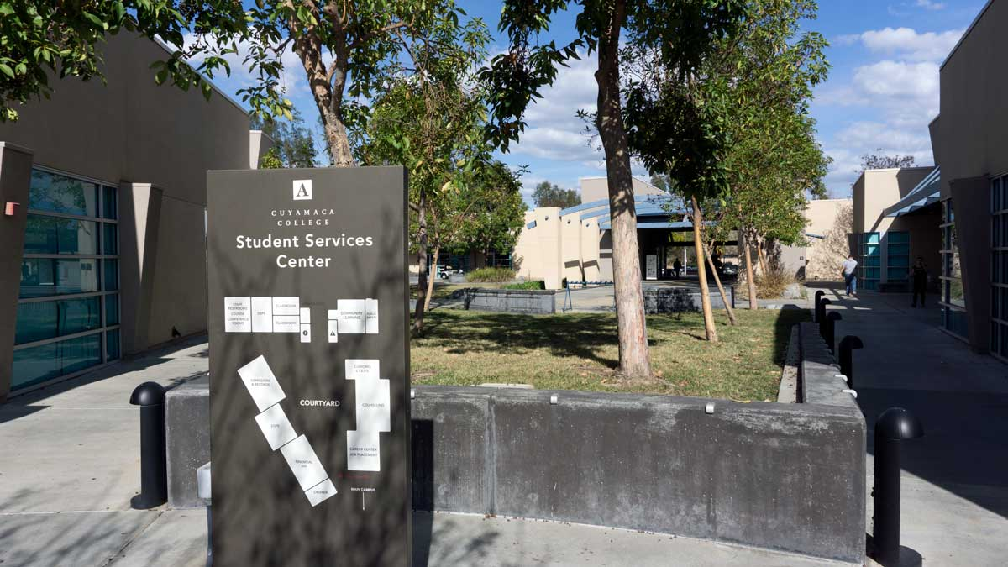
Cuyamaca’s Middle Eastern Community?
The majority are Chaldean Iraqi refugees.
Low income.
Main goal is to learn English.
Seek short term degrees and highly interested in career technical programs.
We are serving a variety of age groups.
Due to language and social barriers, those students may experience stress and anxiety.
Simple things can add to their stress such as sending an email, filling out a form, waiting on their FA award, booking a counseling meeting, etc.
To cope with stress, they look for staff and faculty that speaks their language,
Take classes in groups.
Have created community groups to discuss school related matters and exchange information.

Slide 10
What can we do to help? Based on observations & students’ feedback
Be detailed and break things down into steps.
Don’t overwhelm with lots of information (keep it clear and straight to the point).
Use visuals (in person or in Zoom).
Use bigger font, bold, color or highlight to capture their attention.
Use common words when possible (avoid American slang).
Expect minimal computer skills.
Don’t assume that students who can speak English write it as well and vise versa (Social vs Academic English).

Slide 11
What can we do to help? Based on observations & students’ feedback
Provide students a timeline for processes.
Provide translation services.
Celebrate their cultural differences. For example, learn few Arabic words like “Hello” and “Thank you”.
For classrooms:
Provide Sample answers, Study Guides, Examples, Templates.
Occasionally, our content may not be applicable for our ME students. (provide modifications)
ME students appreciate group work and even group presentations.
When using YOUTUBE, find videos with subtitles.
Provide feedback even if using a Rubric.
Family and religious values will come up in discussions and activities.
Exams make them very anxious, provide study guide, give ideas/hints on what the questions will be like. They take exams very seriously.

Slide 12
Final Thoughts
The Middle East is very diverse in terms of ethnicities, religions, and languages, appearance, life style, and expectations.
Despite all this diversity, people were able to coexist and create a thriving society.
Even with our immigrant/refugee population, people try to keep those traditions and pass them into the new generations.
Finally, each student on our campus has a unique story.
Our refugee/immigrant population in particular, have witnessed various hardships in the past (Loss of jobs and homes, Changes in government and wars, death, illnesses, kidnapping) and they come here and they experience a new world with a new language, new norms, and way of life.
Being aware of this will allow us to better serve those students based on our role on campus.

