Slide 1
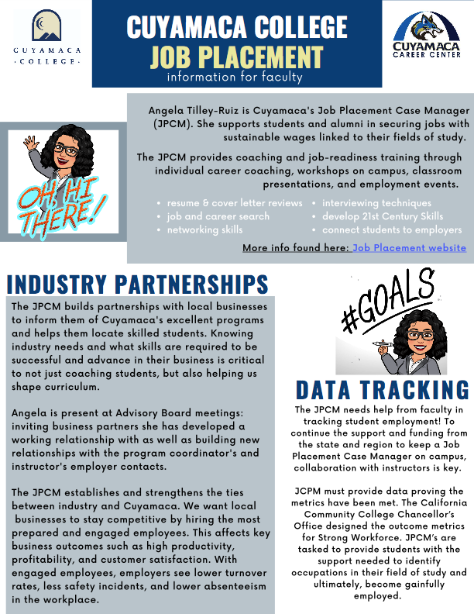
ANGELA.TILLEY@GCCCD.EDU
CUYAMACA.CAREER@GCCCD.EDU

Slide 2
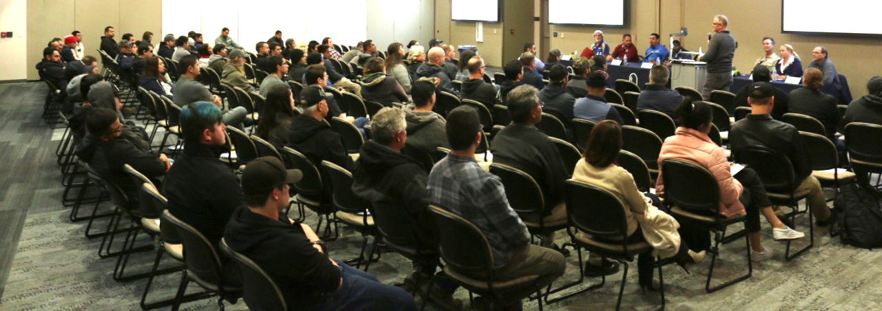
ANGELA.TILLEY@GCCCD.EDU
CUYAMACA.CAREER@GCCCD.EDU

Slide 3
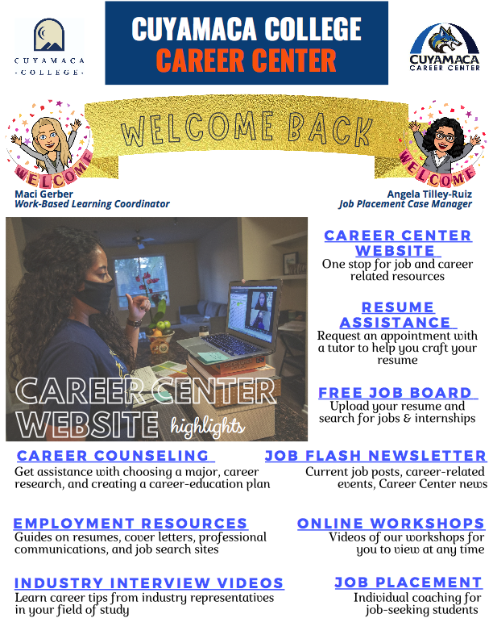
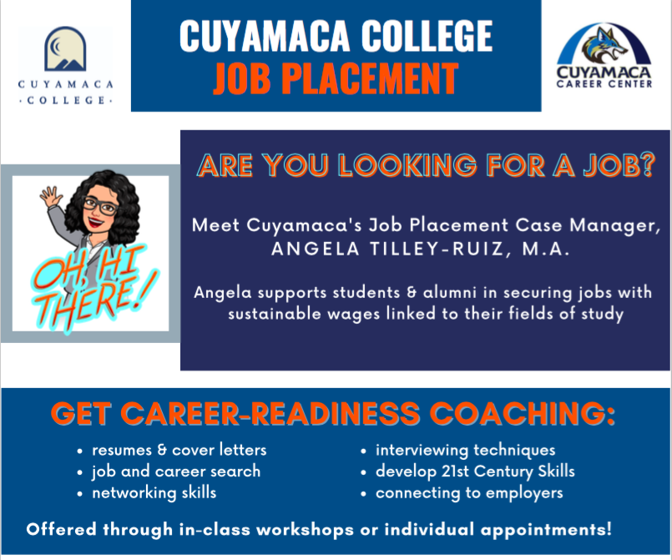
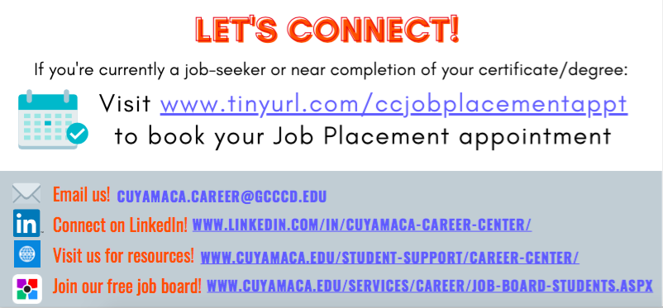
STUDENT FLYER

Slide 4
WORKSHOPS
Watch Career Center’s recorded workshops on our website
Invite our industry partners to facilitate a 45 – 90min. workshop in your class:
Resume and Cover Letter
Interview Skills
Financial Literacy
Ace the Interview
Resume Builder
Find a Job
Workplace Communication
Conflict Resolution
Classes can take the whole series to work toward earning a Job Readiness certificate

Slide 5
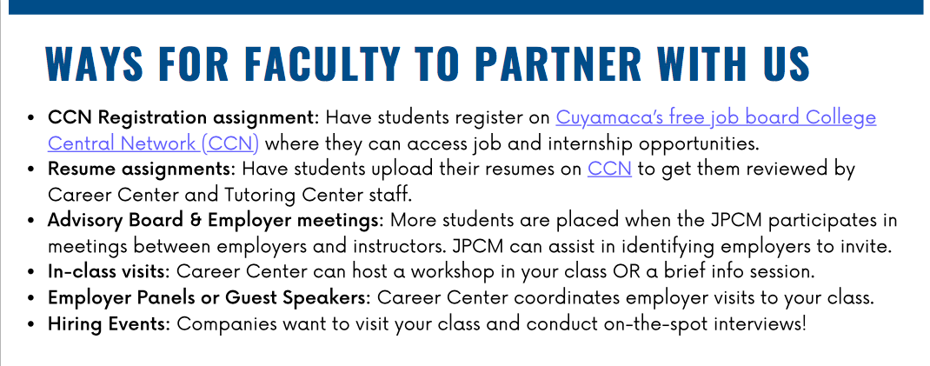
ANGELA.TILLEY@GCCCD.EDU
CUYAMACA.CAREER@GCCCD.EDU
CUYAMACA’S FREE JOB BOARD: www.tinyurl.com/CuyamacaJobBoard

