Slide 1
Program Review Steering Committee Update 2021-2022

Slide 2
Committee Membership Changes
New Student Services co-chair: Liza Ashak
Administrative: Bri Hays
Student Services: Liza Ashak
Instructional: Nancy Jennings

Slide 3
PRSC Report Types
Comprehensive Reports (every four years)
Long-term (4-year) goals and plans
Strengths, Challenges, External Influences Analysis
Curriculum review
Deep dive into the (achievement and learning outcome) data
Resource requests
Annual Updates (all programs)
Annual update on progress toward long-term goals
Update on achievement and learning outcome data
Resources needed to fully accomplish goals

Slide 4
Comprehensive Reports for 2022-2023
ASL
CADD
Chemistry
Child Development
CIS
Economics
EHSM
English
Geography, Geology & Oceanography
Health Education
History
Library
Sociology & Social Work
Tutoring

Slide 5
PRSC Fall Semester
Data available end of spring semester/beginning of summer
Support for Authors
Training Workshops
Office Hours
Offer Support/Answer Questions
Reports Due– end of December

Slide 6
PRSC Spring Semester
Collect/Review Reports
Author Presentations for Comprehensive Reports
Complete Feedback Forms
Send author survey
Review survey feedback
Revise Templates
Revise Rubrics/ Feedback Forms

Slide 7
Earlier Report Due Date
In the past– middle of January
This past year- December 17
Survey Feedback– deadline too tight
December Due Date in place for 2022
May revise back to January for 2023

Slide 8
Report Template Proposed Changes
No substantive content changes
Renumbered (retained sections)
Removed repetitive questions
Separated two part questions into separate questions
Updated names of various contact people
Updated to current vision and goals
Included vision in questions

Slide 9
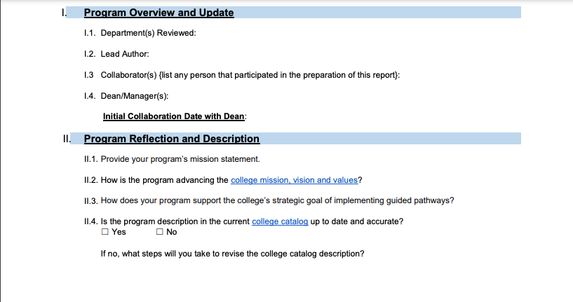
Example from old Template

Slide 10
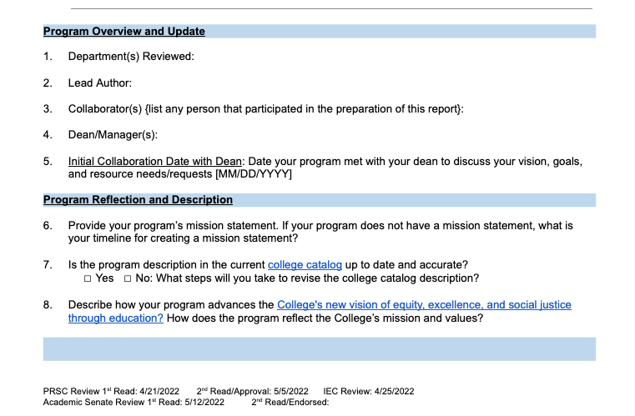
Example from New Template

Slide 11
Proposed New Templates
Note: there is also an administrative template, but it does not come to Senate for approval.
Instructional Program Comprehensive
Instructional Program Annual Update
Student and Instructional (Library/Tutoring) Services Comprehensive
Student and Instructional (Library/Tutoring) Services Annual Update

