Slide 1

Open Education Resources (OER) @
Cuyamaca College
Josh Franco, Ph.D.
Assistant Professor
OER Coordinator 2022-2024

Slide 2
What is OER?
According to Creative Commons Wiki, Open Educational Resources (OER) are teaching, learning, and research materials that are either
  (a) in the public domain or
  (b) licensed in a manner that provides everyone with free and perpetual permission to engage in the 5R activities.

Slide 3
History of OER @ Cuyamaca
2019
ISER outlines Project #2: Expand Open Educational Resources/ Low-Cost Course Materials
2019
Karla Gutierrez, Assistant Professor of Spanish and Chair of World Languages Department, serves as inaugural ASCCC OER Liaison
2020
Dr. Josh Franco, Assistant Professor of Political Science, serves as ASCCC OER Liaison
2021
OER Committee Charge and Composition vetted and approved, OER Coordinator role established
Reports to Academic Senate and Institutional Effectiveness, Success, and Equity Office
2022
OER Coordinator funded; Dr. Franco appointed as inaugural OER Coordinator

Slide 4
About Your OER Coordinator/ASCCC OERI Liaison
A.A. degrees in economics and political science from Cerritos College, and a B.A. in public policy and M.A. and Ph.D. in political science from the University of California, Merced
Co-authored Introduction to Political Science Research Methods (IPSRM) OER textbook
Authored Polimetrics: A Stata Companion to IPSRM OER workbook
Co-authored an Introduction to International Relations OER textbook equivalent
Co-authored an Introduction to Comparative Politics OER textbook.

Slide 5

Outlook for 2022-2023
Attend
Attend OER professional development meetings
Meet
Meet individually with faculty and staff interested in:
a brief introduction to OER
adopting existing OER
curating existing OER
creating new OER
writing OER grant proposals
Present
Present at Shared Governance Councils and Committees
Recruit
Recruit individuals to serve on the OER Committee
Prepare
Prepare College’s ZTC Program Proposal to CCCCO
Attend ASCCC OER Liaison meetings and events
Present an ASCCC OERI webinar
Prepare implementation of LTC designation
Recruit faculty and staff who want to apply for future ASCCC OERI grants

Slide 6

When In Doubt about OER…

Slide 7
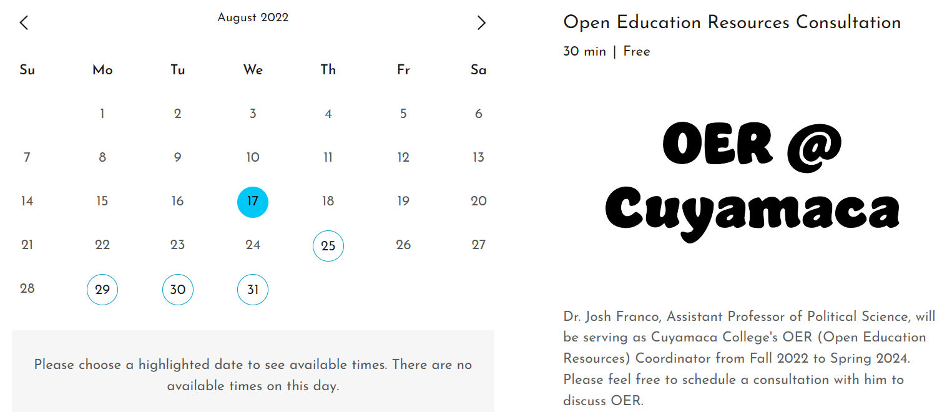
Self-Schedule an OER Consultation with Me

Slide 8
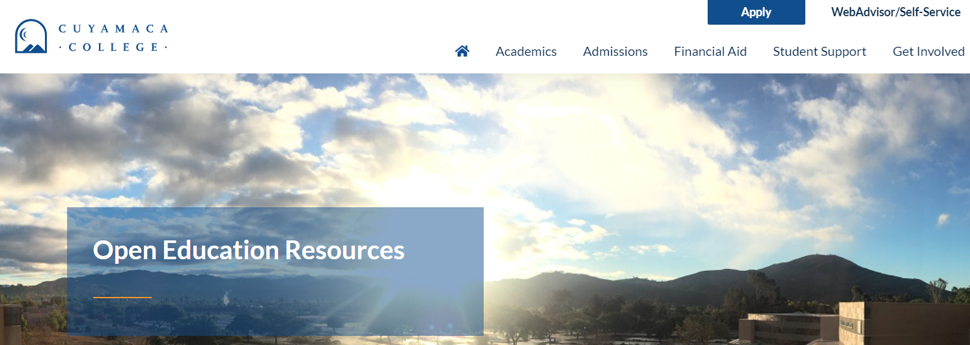
Visit OER @ Cuyamaca College Website

Slide 9

Feel free to contact me with questions about OER
Email me: josue.franco@gcccd.edu
Call me: 619-780-5674
Text me: 619-780-5674
Self-Schedule a Consultation with Me

Slide 10

Let’s Get Into the OER Weeds

Slide 11
What is OER?
According to Creative Commons Wiki, Open Educational Resources (OER) are teaching, learning, and research materials that are either
  (a) in the public domain or
  (b) licensed in a manner that provides everyone with free and perpetual permission to engage in the 5R activities.

Slide 12
What are the 5Rs?
Retain – make, own, and control a copy of the resource
Revise – edit, adapt, and modify your copy of the resource
Remix – combine your original or revised copy of the resource with other existing material to create something new
Reuse – use your original, revised, or remixed copy of the resource publicly
Redistribute – share copies of your original, revised, or remixed copy of the resource with others

Slide 13

About The Licenses - Creative Commons

Slide 14

What is ZTC?
ZTC means zero textbook costs.
  Zero Textbook Cost, or ZTC, means that the instructor has self-reported adopting a textbook that cost zero dollars for students.
  SB 1359 is a state law that requires California Community Colleges to designate Zero Cost Textbook course sections.

Slide 15
ZTC Statistics
Summer 2022:
  Cuyamaca College:
    12 ZTC sections out of a total of 112 sections.
    10% of sections are ZTC.
  Grossmont College:
    73 ZTC sections out of a total of 204 sections.
    36% of sections are ZTC.
Fall 2022:
  Cuyamaca College:
    134 ZTC sections out of a total of 746 sections.
    18% of sections are ZTC.
  Grossmont College:
    412 ZTC sections out of a total of 1465 sections.
    28% of sections are ZTC.

Slide 16
What is LTC?
LTC means low textbook costs.
  The Cuyamaca College Academic Senate adopted a resolution in Spring 2022 to locally define LTC as up to $40 dollars.
    The Grossmont College Academic Senate also adopted the same $40 threshold.
  Goal is to implement LTC designation during AY22-23.

Slide 17
Relationship between No Text, ZTC, LTC, and OER
Course sections could be:
  No Text: Have no associated instructional material
  ZTC-B: Use only no-cost open educational resources
  ZTC-C: Have instructional material costs, none of which are passed on to students
  LTC: Have low instructional materials costs
    $40 or less for Cuyamaca College
  None of the Above: Not meet the no-cost or low-cost instructional material criteria

Slide 18
What are Instructional Materials?
Any of the following required for a course:
Textbooks
Digital course materials
Open educational resources
Institutional licensed campus library materials that all students enrolled in the course have access to use
Other properly licensed and adopted materials
Access codes to digital course materials
Materials defined in the Disabled Student Services General Provisions section
AV work required for student’s success
Instructional materials does not include:
Instructional supplies or equipment like uniforms, yoga mats, paint brushes, calculators, etc.

Slide 19
Again, feel free to contact me with questions about OER
Email me: josue.franco@gcccd.edu
Call me: 619-780-5674
Text me: 619-780-5674
Self-Schedule a Consultation with Me

Slide 20

Questions, Comments, Concerns, Suggestions?

