Slide 1
Supporting Faculty Through the Academic Senate
Grossmont-Cuyamaca Community College District
1/30/2025

Slide 2
Introductions and Acknowledgments
A moment of silence to acknowledge those impacted by the fires in LA and San Diego.

Slide 3
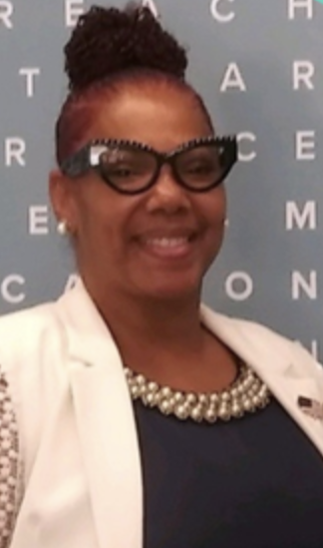
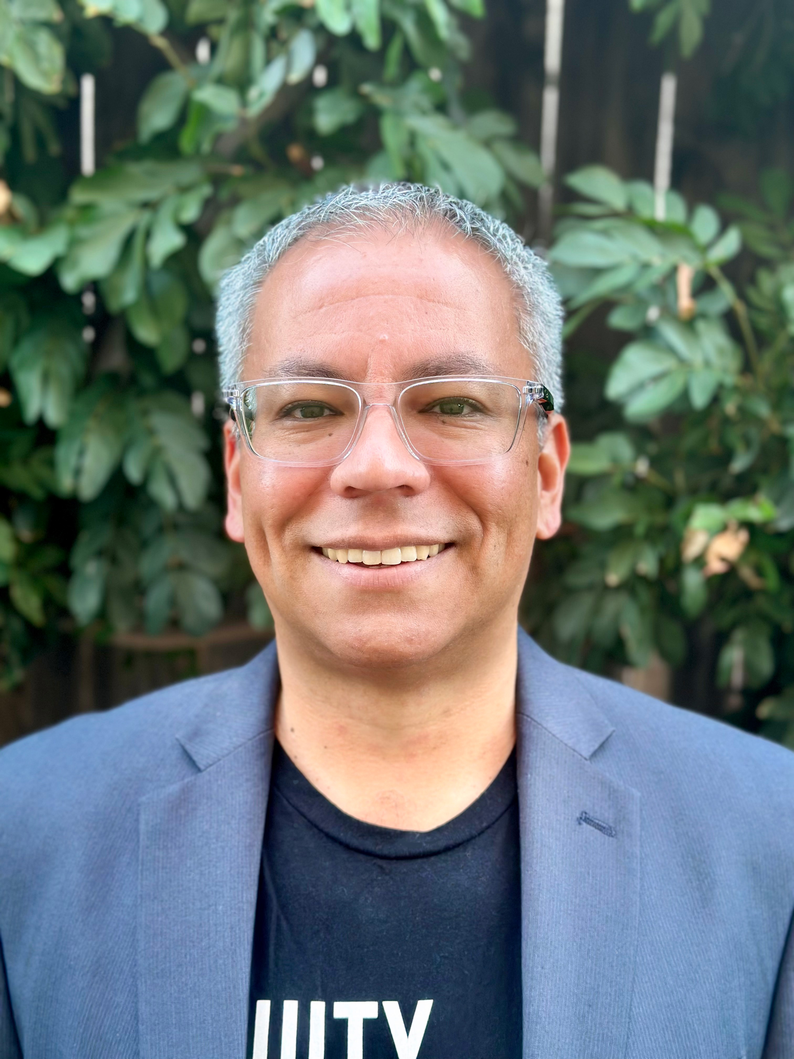
ASCCC Presenters
LaTonya Parker, Ed.D.
ASCCC Vice President
Riverside Community College
Luke Lara, Ed.D.
ASCCC South Representative
MiraCosta College

Slide 4
Faculty Voice and Support
Introductions and Acknowledgement
What we Know
What’s Going on?
Three Activities
Defining Community
Reframing
Pyramid of Success Framework
Academic Senate as a Role Model for Change
Paving the Path Forward
Agenda

Slide 5
"If you want to go quickly, go alone. If you want to go far, go together " - African Proverb.
This Photo by Unknown Author is licensed under CC BY

Slide 6
Community Agreements¹
We work to collectively empower faculty and students.
We share the responsibility of upholding Cuyamaca’s Mission, Vision, and Values.
We support, value, and learn from each other.
We aim to be as transparent, honest, and constructive as possible.
We seek a balance of voices and understand that expressing different opinions is allowed and welcome.
We uphold that our personal experiences matter and must be respected and believed.
We strive to strengthen partnerships across our campus and the District.
¹Cuyamaca College Academic Senate Community Agreements

Slide 7
What we Know
Partnership moves at the speed of trust
Trust is the relative absence of fear
Naming fears removes their power
The only one you can change is yourself
Notes:
I want to acknowledge that everyone in this space is committed to and invested in the Academic Senate for myriad reasons. We may have different ideas, but the diversity of perspectives and experiences will make the Academic Senate and faculty voice strong.

Slide 8
What's Going On?
Issues with communication?
Low morale?
Faculty and staff of color leaving?
What else related to faculty and Academic Senate?
Personal life issues?
Write your thoughts on a sticky note and put it on a posterboard

Slide 9
Activity 1
On the 3x5 index cards, complete the following sentence:
“My name is_____ and I love working at my college because ______”
Introduce yourself to as many people as possible with this statement and move on to another person.

Slide 10
Activity 2
On the paper plate, write in the center of the plate about a time when you let someone down (a colleague, a student, or yourself).

Slide 11
Activity 3
On a Post-it note, briefly write about how your vision for the future of your Academic Senate. Place the Post-it note on a posterboard. Take a moment to read what others post afterward.

Slide 12
Defining Community
Are we connected?
Are we safe?
Do we share a future?
Daniel Coyle’s Cues of Belonging from The Culture Code

Slide 13
Reframing
Themes that came up
Actions that can lead us forward

Slide 14
Pyramid of Success¹
Community Success
Effective and Engaging Leadership
Relational: Trust/Mutual Respect/ Authentic Care
¹Adapted from “Teaching Men of Color in the Community College: A Guidebook” by Drs. J. Luke Wood, Frank Harris III, and Khalid White
Notes:
How do you know when someone trusts you? It takes a long time to develop trust, and it can be easily broken.
How do you develop mutual respect? Relationships take an effort to maintain.
How do you show authentic care? Relationships will always be tension, with ups and downs, if authentic.

Slide 15
Academic Senate as a Model for Change
Trust, Mutual Respect, and Authentic Care
Leading together
Establishing partnerships
Centering humanity in relationships
Communicating with purpose and transparency
Being kind and learning from one another
This Photo by Unknown Author is licensed under CC BY-SA
Notes:
Student Senate, Classified Senate, Bargaining units, Administration

Slide 16
Paving the Path Forward
What do you have in place now to address Community and Communication issues?
What are the opportunities to unite and work together to improve community building and better communication across the district?
What are you willing to commit to doing going forward?

Slide 17
Recent Foundational Steps
Resolution for Adopting and Maintaining Equity-Minded Communication Guidelines (Spring 2023 – adopted by both Cuyamaca and Grossmont Academic Senates)
Cuyamaca College Academic Senate Community Norms (Fall 2024 – Cuyamaca Academic Senate)
Resolution in Support of More Collaborative, Effective, and Equitable Participatory Governance Practices and Policies (Spring 2023 – Cuyamaca Classified Senate and Academic Senate – joint resolution)
Collegiality in Action Presentation (Fall 2024)

Slide 18
Thanks
Remember your humanity
Have patience as change takes time
Remember to share gratitude more than criticism
We all have a shared purpose, want to feel safe, and want a shared future
Lastly, trust, authentic care, and mutual respect begins with each of you

Slide 19
Resources
ASCCC Caucuses
Faculty Empowerment Leadership Academy
IDEAA Tools and Resources:
Lara, L., & Slabbnick, R. (2024, April). Encouraging practices toward developing a diverse and inclusive faculty leadership pipeline. Senate Rostrum.
Local Senates Handbook
Mentorship Handbook

Slide 20
How Can Senate Impact Community Building?
Academic Senate 10+1
Policies for faculty professional development activities
Education Code: § 87360 (b) Hiring Criteria
Requires the local Board of Trustees to develop hiring criteria, policies, and procedures for new faculty members.
Education Code: § 87610.1(a) Tenure Evaluation Procedures
Requires that collective bargaining agents, or faculty collective bargaining units, consult with the academic senate prior to negotiating tenure evaluation procedures

Slide 21
What can the Academic Senate do?
What is the Academic Senate?
TITLE 5: §53200 Definitions – Academic Senate is an organization whose primary function is to make recommendations with respect to academic and professional matters through collegial consultation (rely primarily or mutually agree)
Who makes up the Academic Senate?
TITLE 5: §55302 Formation; Procedures; Membership – The full-time faculty and part-time faculty.
What power does the Academic Senate have?
TITLE 5: §53203 Powers – The governing board shall adopt policies for the appropriate delegation of authority and responsibility to its college academic senate.

Slide 22
Academic and Professional Matters
Academic and Professional matters (also known as the “10+1”) means the following policy development matters:
Curriculum, including establishing prerequisites.
Degree and certificate requirements.
Grading policies.
Educational program development.
Standards or policies regarding student preparation and success.
College governance structures, as related to faculty roles.
Faculty roles and involvement in accreditation processes.
Policies for faculty professional development activities.
Processes for program review.
Processes for institutional planning and budget development.
Other academic and professional matters as mutually agreed upon.

