Slide 1

Financial Aid Office Update
A comprehensive look at our progress, data insights, and strategic path forward
Financial aid removes barriers so students can enroll, persist, and complete their educational goals

Slide 2


Where We Started: Navigating Transition
Major System Implementation
Significant Staffing Turnover
Colleague Financial Aid launched August 2024
Complete operational overhaul during transition
Financial Aid Advisor resignation
Financial Aid Assistant resignation
Existing full-time Advisor vacancy
Part-time Advisor retirement (Dec 2024)
Scholarship Specialist vacant 5 years
Financial Aid Supervisor retirement
In-reach was essentially non-existent: no classroom presentations, no financial aid labs for special programs, limited high school partnerships

Slide 3
Building Operational Excellence
Strategic improvements across systems, compliance, and staffing
System & Compliance Wins
Staffing Transformation
Colleague Financial Aid successfully launched
Brand-new compliant policies and procedures
Renovated website with student-centered language
Bi-weekly staff meetings established
5 of 9 NASFAA certifications completed
Hired Scholarship Specialist (5-year vacancy filled)
Created first Financial Aid Technician role
Fully staffed team: Assistant, Assistant Sr., Technician, 4 Advisors, Scholarship Specialist, Supervisor, and Director

Slide 4
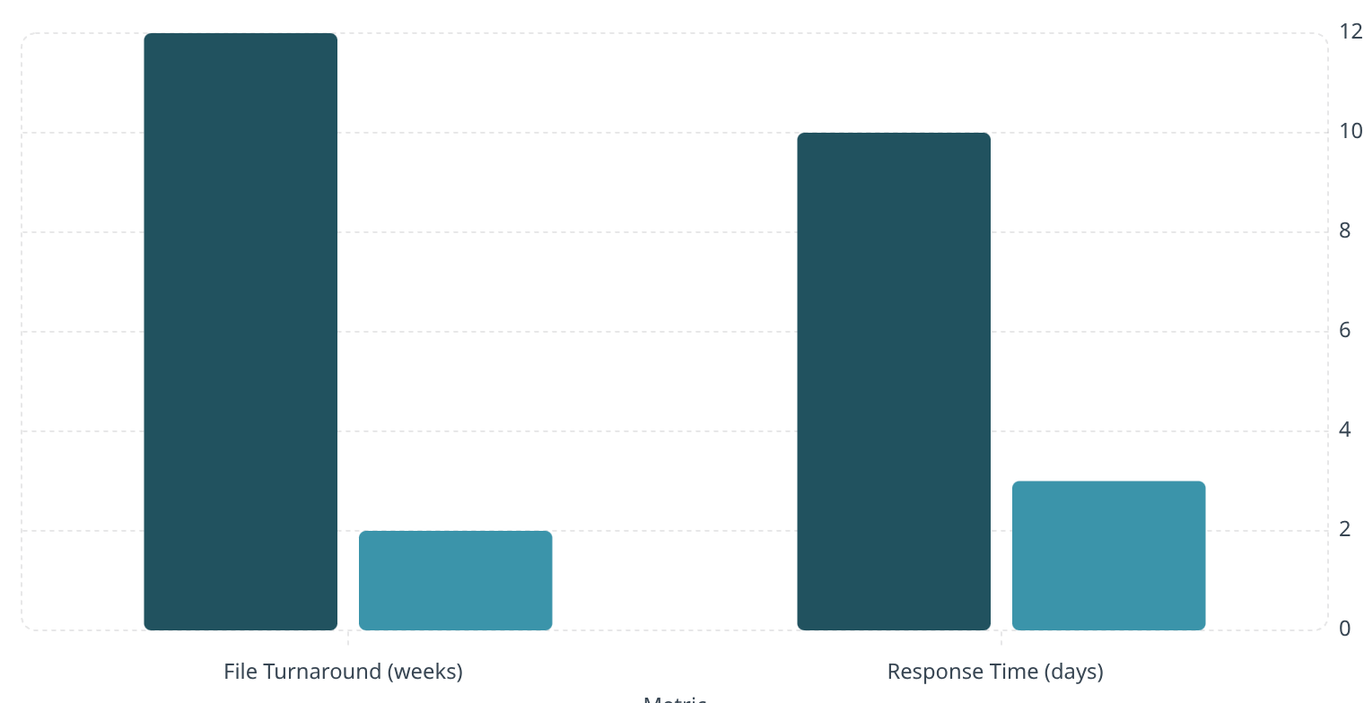
Measurable Progress: The Numbers Speak
June 2024
Current
Transformative Improvements
File turnaround reduced by 10 weeks in just one year
Phone & email response down from 10 to 3 business days
Financial Aid Labs: 491 students (2024) → 577 students (2025)
$14.4M
$16.2M
$9.8M
Pell Disbursement 2023/24
Pell Disbursement 2024/25
As of Feb 2026
On track to exceed last year
Nearly $2 million increase in Pell disbursements — faster processing means students can pay rent, buy books, and stay enrolled

Slide 5

Protecting Students: Return to Title IV Excellence
How cross-campus collaboration prevents unnecessary student debt
The Challenge
Our Solution
Federal regulations require accurate last dates of academic engagement for withdrawals
Teresa Steward, Financial Aid Technician, proactively collaborates with faculty to confirm actual engagement dates
Old approach: Default to semester midpoint when date unknown
More accurate reconciliation
Reduced institutional error
Lower student balances owed
Result: Students owing $1,000–$2,000+ unnecessarily
Faculty responsiveness directly protects students from financial hardship

Slide 6
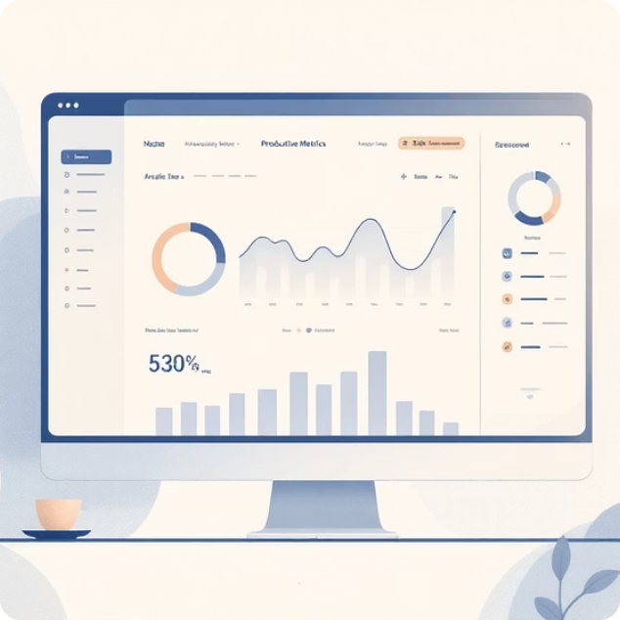


Data-Driven Strategy
Weekly tracking and collaborative analysis inform every decision
Weekly Activity Monitoring
Equity Analysis Partnership
Strategic Collaboration
Productivity trends
Turnaround times
Caseload volume
Students served
Collaboration with Bri Hayes & Katie Cabral tracking:
Working with VP Dr. Marron to:
Reduce institutional error
Improve staff training
Decrease wait times
Target at-risk students
Application completion rates
Aid received by race & ethnicity

Slide 7
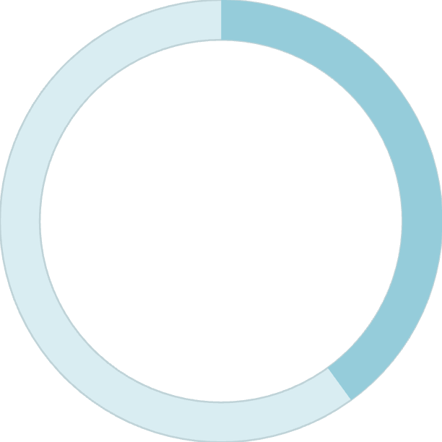
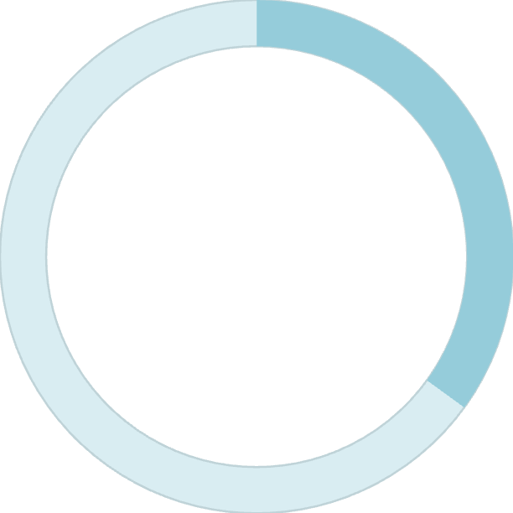
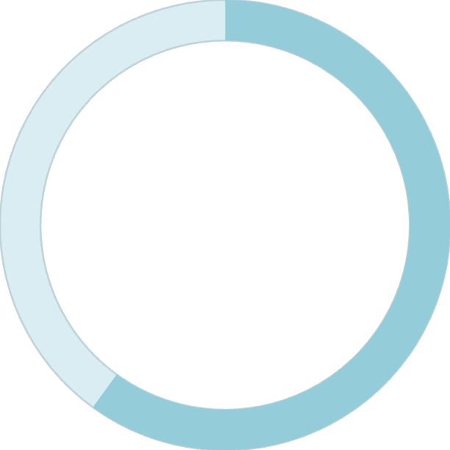

Application Completion: The Reality Check
40%
35%
60%
2023/24
2024/25
Peer Institutions
FAFSA only
Any financial aid application
Our comparator schools
Expanded Tracking
Starting 2024/25, we now track all application types:
FAFSA (34% completed)
CADAA
CCPG
Any financial aid application (35% total)
2025/2026 aid year ongoing — current completion remains approximately 35%
We have significant work to do

Slide 8


Our Institutional Commitment: 50% by 2027/28
Year 3: 50%
Year 2: 45%
Year 1: 40%
Baseline 35%
Annual 5% increase over three academic years, starting from our 35% baseline
This is an equity commitment. When students don't apply, they don't access Pell Grants, state grants,
or fee waivers.
This is where we need partnership with you

Slide 9

Faculty Partnership: The Path Forward
Building on scholarship presentation success to expand financial aid access
Proven Success Model
Scholarship classroom visits → record applications
Growth happened because you opened your classrooms
Expanding to Financial Aid Presentations
FAFSA, CADAA, CCPG awareness
Application walkthroughs
Address misconceptions
20-minute classroom visits
Spring 2026
Fall 2026
Develop framework and resources
Full implementation launch
1
2
3
Summer 2026
Train Federal Work-Study students
FWS Student Ambassadors will: Raise awareness, provide hands-on support, target special programs with equity gaps
From 35% to 60%: That growth will happen through partnership. Thank you for being part of this work.

