Slide 1
Handshake 101
A guide for Cuyamaca Students
By Jacquelyn Rico | Cuyamaca Student | Career Center Assistant

Slide 2
Overview
Here is what you can expect to learn on this journey to discovering Handshake:
What is Handshake? | Purpose of Handshake and why its a tool students should use
Getting started on Handshake | Activate your Handshake account and learn how to set up your profile
How to find jobs and internships | How to maximize the benefits of Handshake in order to get job/internship postings that align with your needs
Developing a network on Handshake | Networking explained, its importance, and how you can use Handshake to do so!
Frequently Asked Questions | Answers to questions you may have
Cuyamaca Career Center Resources | In need of further assistance? The Career Center can help!

Slide 3
What is Handshake?
Handshake is an online job board that connects students, their schools, and potential employers.
On the website, you can find job and internship listings, upcoming events to build your career, and helpful resources from around Cuyamaca.
Handshake's mission statement is, "to help every student find a great job and build the foundations of a meaningful career, no matter where they're from or who they know."

Slide 4
Cuyamaca Career Center
Handshake is designed for students and recent alumni. Employers come to Handshake looking for employees with YOUR exact level of experience.
Woohoo, I just got my first internship!

Slide 5
Getting started on Handshake
Activate your account:
Handshake can be used on either your computer or mobile device. To activate your account, search joinhandshake.com and select Cuyamaca as your college.
Now that you're ready to start using handshake, visit https://tinyurl.com/starthandshake and view the step-by-step instructions to build your profile.
Getting started:
Great question! By completing your profile, Handshake will begin to give you personalized job and internship recommendations that are more relevant to your career of interest and your likelihood of being messaged by a recruiter will increase!
"Now what?"

Slide 6
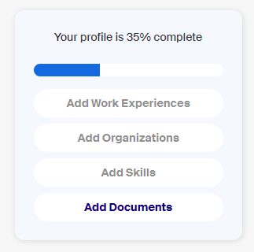
Jackie's take – Setting up my profile
One of the tools that I found most handy when completing my profile was the box that shows you your percentage of completion. As I clicked on the blue words, it would prompt me to further upload information until I got closer to 100%, signifying my profile was complete. It felt like a check off list that directed me to the next steps with just one click, making it easier to complete my profile!
Remember to upload a professional picture of yourself! Having a profile picture will help you receive more engagement. Don't forget that you want to be leaving a good impression on potential employers or networking opportunities, so make sure it's a professional photo of you!

Slide 7
How to Find Jobs and Internships
Filters and Keyword search
Go to the job search page by clicking Jobs on the menu bar of your Handshake account. Here you'll see recommended jobs. To narrow them down and make them more specific to what you're looking for, use filters and key words. You can add one or more filters including Job type (including internship, full-time, part-time) and Location. The Employer preferences filter will show you jobs for which the information you have provided on your profile (Major, School Year, Graduation Date) matches what an employer has specified they need. Lastly, Keywords allow you to further specify your filtered jobs by showing you the jobs that have the keyword you have chosen anywhere within the posting.
Let's start this journey!
Save the jobs you like
There are three reasons to be saving the jobs you want to apply for. (1) When you're ready to apply, you'll be able to find them quickly on your dashboard and in the Saved tab on the job search tab. (2) You'll start seeing more relevant job recommendations. As you select the jobs you like, Handshake will show you similar opportunities. (3) You'll receive important notifications about your saved jobs, including reminders to apply before the deadline and emails showing you similar jobs to check out. To save a job, click the bookmark icon located on the right side of the job preview or on the left hand side of the job page (above Role Description).

Slide 8
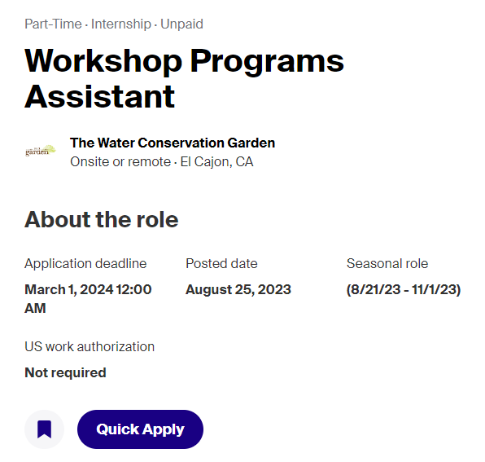
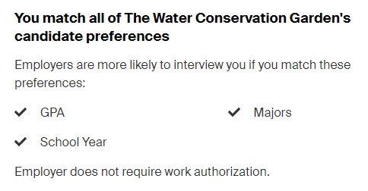
Jackie's take – Finding a Job/ Internship
One of the key words that I typed into the search bar was "conservation" and our neighbors at The Water Conservation Garden popped up! I made sure to save the internship for later reference. Remember, Handshake will give you job recommendations based on your activity! I also found the feature to the right very helpful in that it tells me right away if I match their candidate preferences or not.

Slide 9
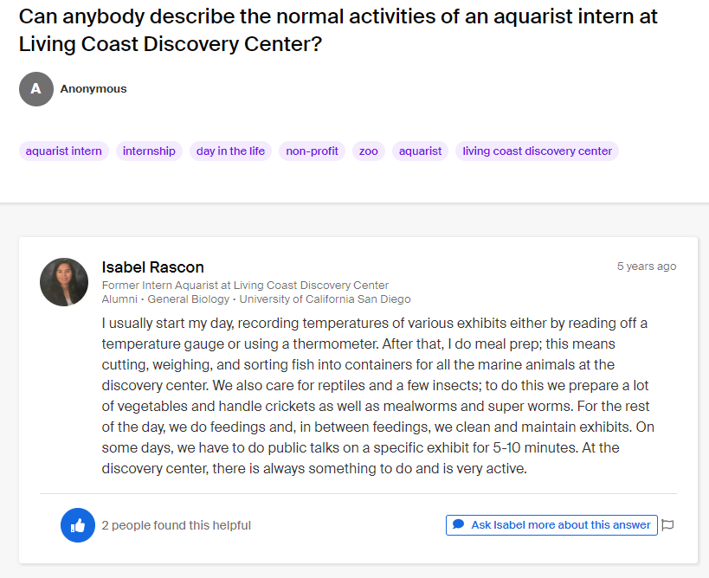
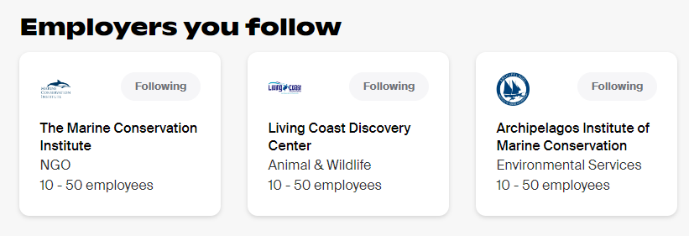
Jackie's Take – More Tips!
While looking for jobs, I came across some awesome organizations that although aren't hiring right now, still have information up on Handshake! I made sure to follow them so that I can get notified when applications open. Another great feature I saw was that students can post questions for past employees to answer! Past employees are also able to leave reviews of their experience and interview tips.

Slide 10
Developing a network on Handshake
What is networking?
How to use Handshake to network:
If you've ever met new people and built a relationship that helped you learn something or achieve a goal – you've networked! Networking simply means connecting with people and cultivating a mutually beneficial relationship.
A helpful feature on Handshake is that it gives students the ability to directly chat with alumni from your school. It can bring a sense of relief to know that someone who attended Cuyamaca has a job at a desirable company but reaching out and connecting with graduates can provide you with even more knowledge and exposure for the role you're applying for. Talking to former students who attended Cuyamaca can help put your career in perspective and push you onto the path you're aiming for. Attending virtual career fairs on Handshake is another great way to network! Cuyamaca is able to host network chats at virtual career fairs and give students the potential to make a connection.
Why is it important?
Networking is one of the most valuable skills you can develop as a student because you will use it through your career. It'll play a major role in how you find new jobs and professional opportunities. People in your network can give you career advice, insight into a new role or industry, or connect you to someone at an employer you want to work for.

Slide 11
Frequently Asked Questions
Which parts of my Handshake profile are most important to include?
Handshake uses your major and job interests to recommend opportunities to you; including job type, job location, and job roles.
What are the top things employers search for?
The most popular fields that employers use to find students they'd like to message include the work experience, skills, clubs, and organizations listed on a student's profile.
Why should I make my profile public?
Employers can find and view your profile only when you make it visible to them. Making it public allows you to show up when they're searching for students to recruit for jobs and internships. Your profile can also be visible to other students, so you'll be able to connect with them for advice!

Slide 12
Cuyamaca Career Center Resources
Resume Assistance
Having a well written and professional resume on your Handshake is important so that you can make a good impression on potential employers! The Cuyamaca Career Center provides guidance and reviews of student resumes. Visit
https://tinyurl.com/cuyamacaresume for more information.
Career Counseling
Cuyamaca offers career counseling and guidance for choosing a major, creating a career-educational plan, and career assistance for students! Visit https://tinyurl.com/careercuyamaca for more information.

