Slide 1
Cuyamaca College Transfer Center Counselors

Slide 2
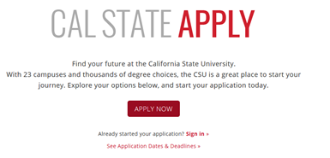
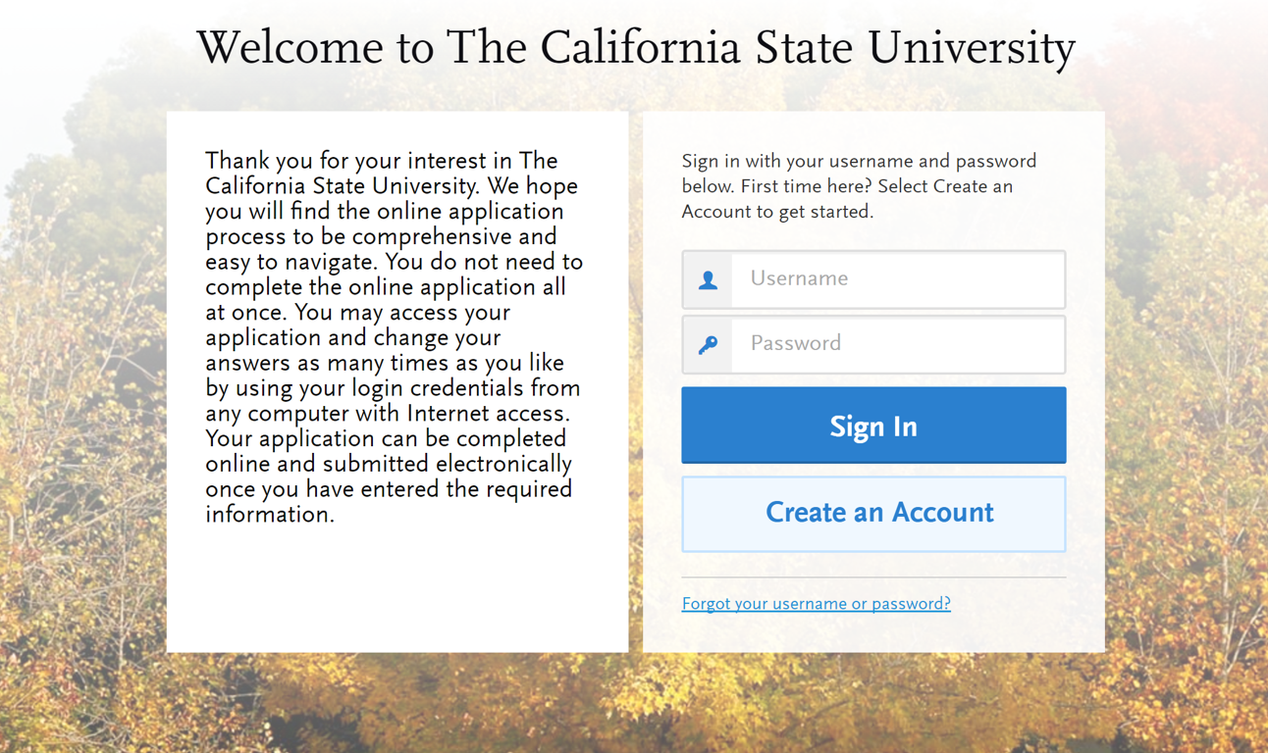
Creating An Account
www.calstate.edu/apply
Notes:
CSU Counselor Conference in Pasadena at the end of this month. April from the Chancellors’s Office will be there again presenting on Cal State Apply updates, and really will be the expert in all things Cal State Apply. I’m happy to write down an questions that I don’t have an answer for to bring to the conference. Or if you know someone who is attending the conference, please have them bring your questions to April.
We also are hosting a small info summit at SDSU for some of our region x counselors who can’t make it to Pasadena. It’s limited at this time to 3 counselors per campus and we’re hoping to have one rep from Transfer, general counseling, and EOPS there. I know Melanie reserved a spot but we do have space for 2 more reps from City.

Slide 3
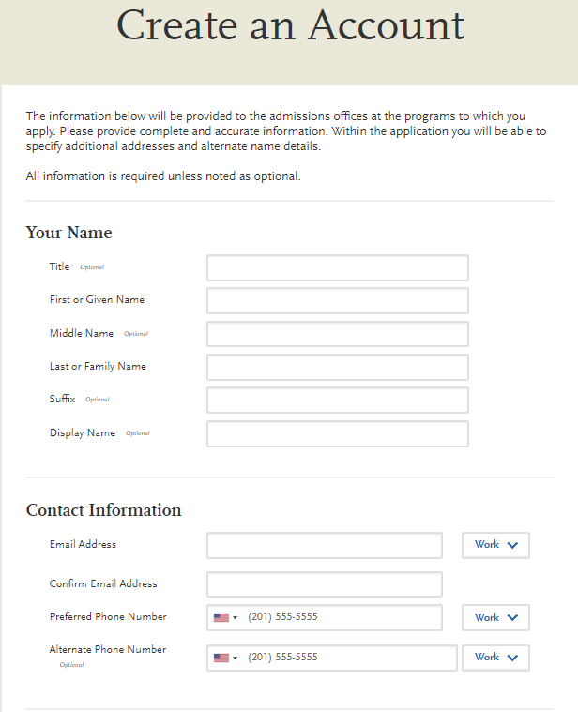
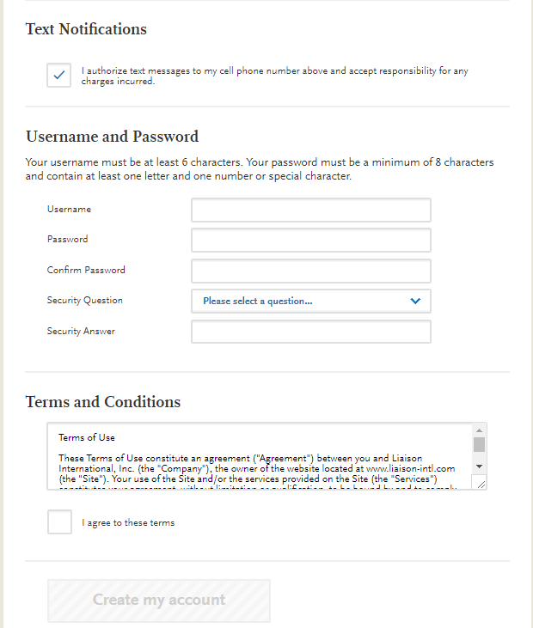
Creating An Account
You will receive communication via email to the address provided.
Updates can be made until the application is submitted. Once an application is submitted you cannot change the information.
Notes:
An email will be received once the account is created (Welcome to CalStateApply email). It’s important that the email address is correct since all communication will be sent to that email. Webportal information will be sent to that email address as well.

Slide 4
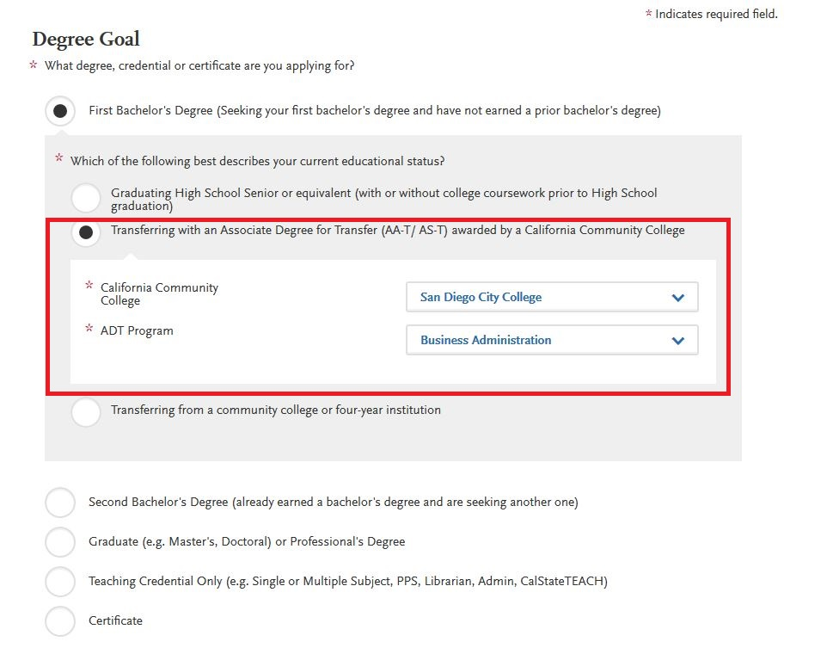
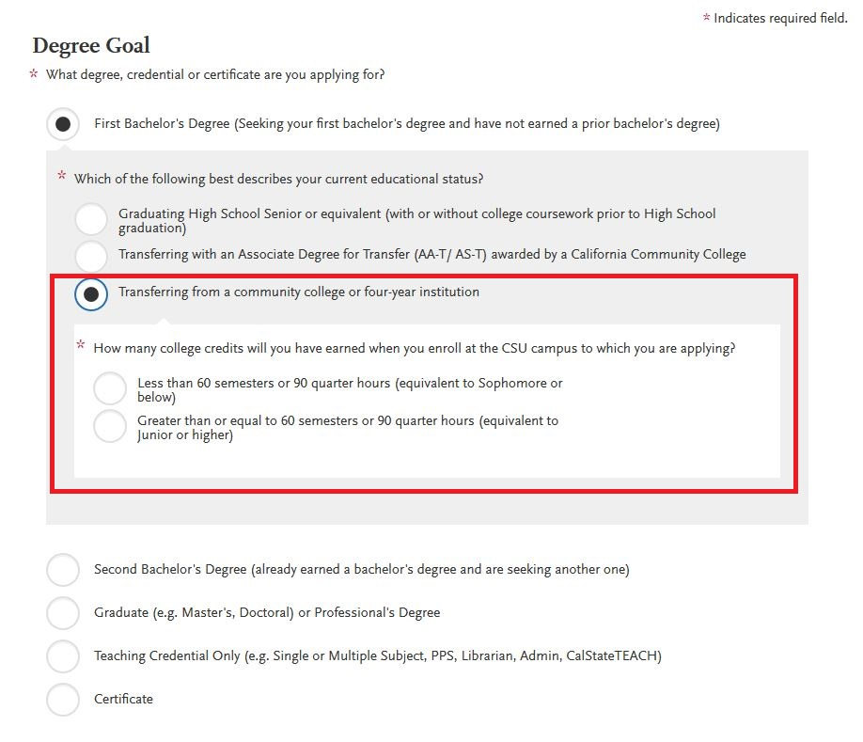
Complete Your Profile
Notes:
If a student is earning an AA-T or AS-T then they will select that option and list the college and program they are applying to. If they are applying with a regular Associates--not an ADT--or just meeting their requirements and transferring to SDSU, they will select “Transferring from a community college or four year institution without an Associates Degree for Transfer--THIS MAY CHANGE --Update expected at Counselor Conference

Slide 5
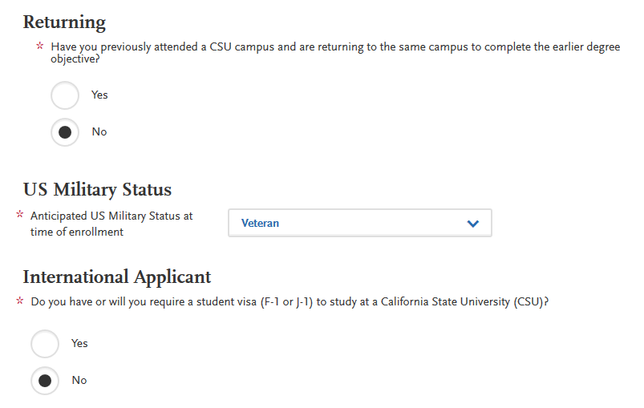
Complete Your Profile
Notes:
For international applicants, some updates have been made to this year’s Cal State Apply. They will no longer be asked questions about EOP, Military status, and other questions that do not apply to those who are stuyding on a F-1 or J-1 visa. Questions for these students should be directed to our International Admissions office.

Slide 6
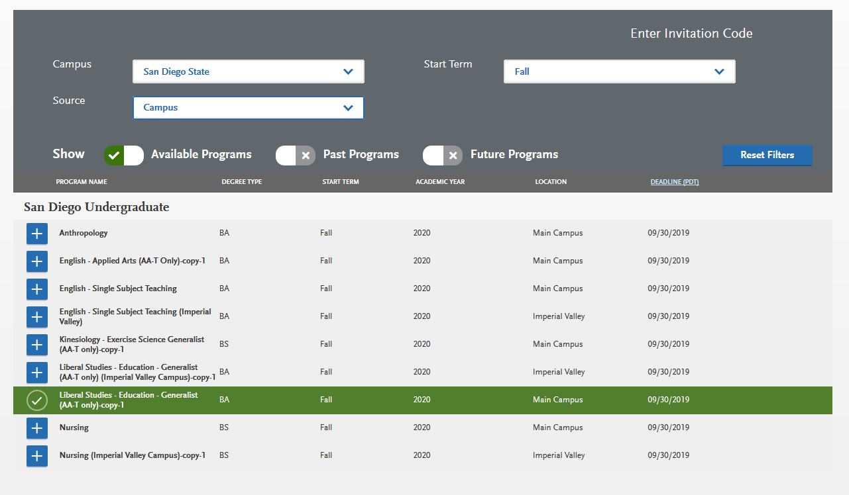
Selecting Programs
Add programs by selecting the plus icon to the left of the program. Multiple programs can be selected but must be at different campuses. One program per campus is allowed.
Additional programs can be added or removed later, prior to the final application submission.
Notes:
You can choose as many campuses as you’d like, but you can only choose ONE program per campus.
This is a crucial area where the student will want to verify they are applying to the correct major based on their transfer pathway. Most mistakes can be corrected on the Supplemental Application, but ADT information is one area that must be correct. Last year we had numerous applications for the Applied Arts Psych program that is only available to ADT applicants, but students either failed to mark themselves an ADT applicant or applied to the Liberal Arts Psyc. The major prep can look different and that will throw off the Supplemental App.
Once you select “I am Done”, the next page will show you the campuses and programs you are applying to and the total Application Fee (at that time).

Slide 7
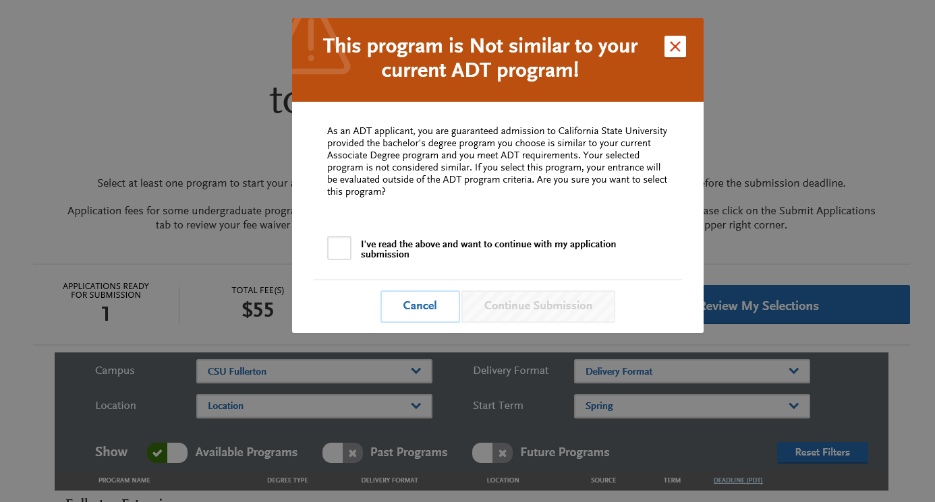
Selecting Programs
Notes:
ADT applicants-If you select a program that is not certified as an ADT, it will provide a pop-up warning letting you know. You will see this if you apply to an ADT program at one campus, and then apply to a non-ADT program at another campus. If you are applying to a non-ADT program,, click that you’ve “read the above and want to continue” box and hit “Continue Submission”.
So same situation with the example of Psychology. Student earns an AA-T in Psych--wants to use it at LB State for admission priority, but want to apply to SDSU’s Liberal Arts Psyc or Industrial Psyc Since neither have an ADT route at SDSU, this pop up will come up. Have then mark it read. ADT will be disregarded for admission bc its not a major that has that degree pathway.

Slide 8
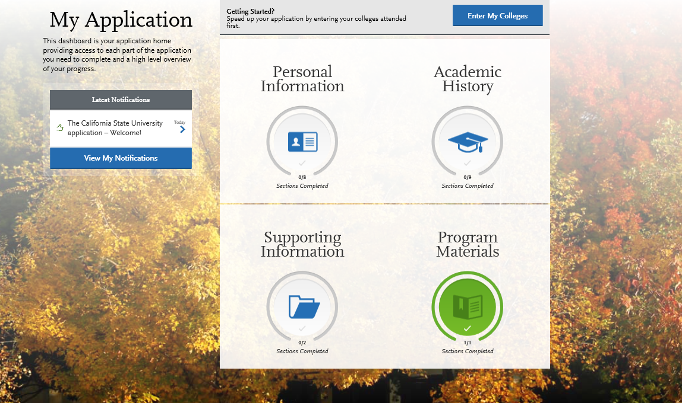
Application Dashboard
The Application Dashboard will help you access different parts of your application:
Personal Information
Academic History
Supporting Information
Program Materials
Notes:
The EOP application is now housed completely in the Supporting Information quadrant.

Slide 9
Application Dashboard
At any point in the application, you are able to update your “My Profile” and “Extended Profile” page.
Note: Changes to profile questions may affect program selection and require re-entry of answers and/or additional questions in the application.

Slide 10
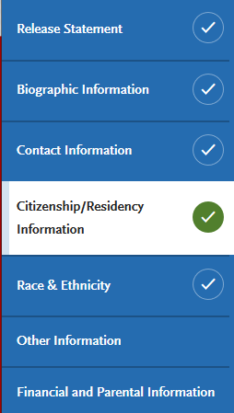
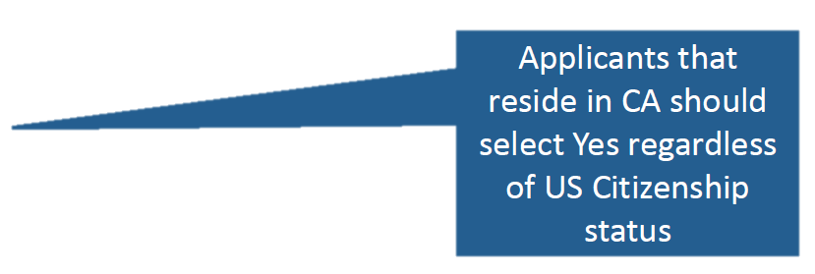
Personal Information – DACA students
U.S. Citizenship questions have been reordered!

Slide 11
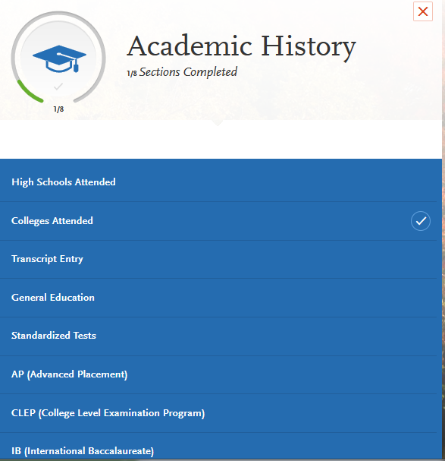
Academic History
First complete the Colleges Attended tile, including all post-secondary institutions attended.
Next complete the Transcript Entry tile, entering ALL courses.
Lastly, in the General Education tile, assign transfer courses to the required CSU GE subject categories
Notes:
The best order to complete this area is listed in the bullet points.

Slide 12
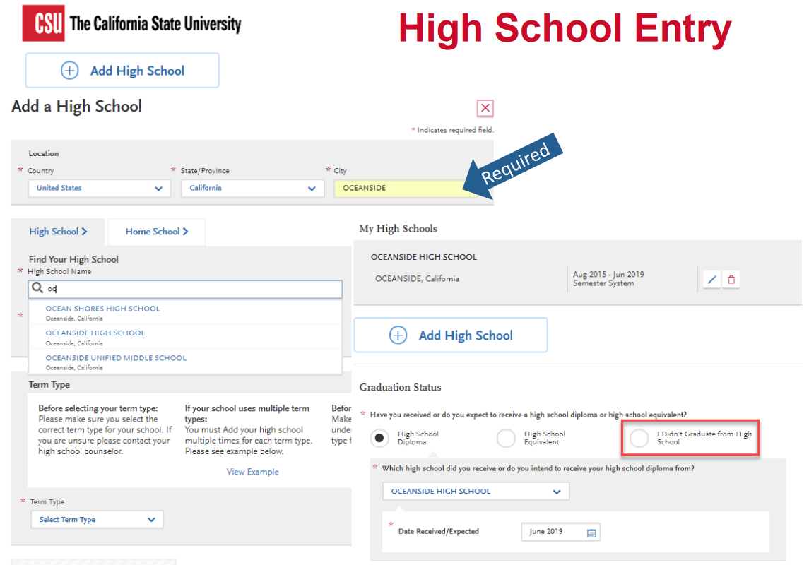

Slide 13
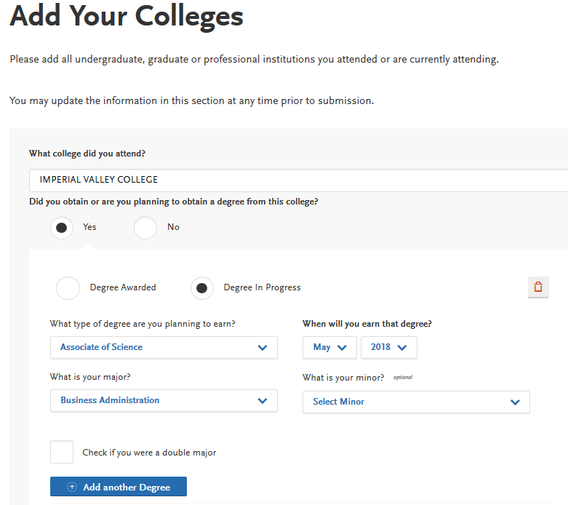
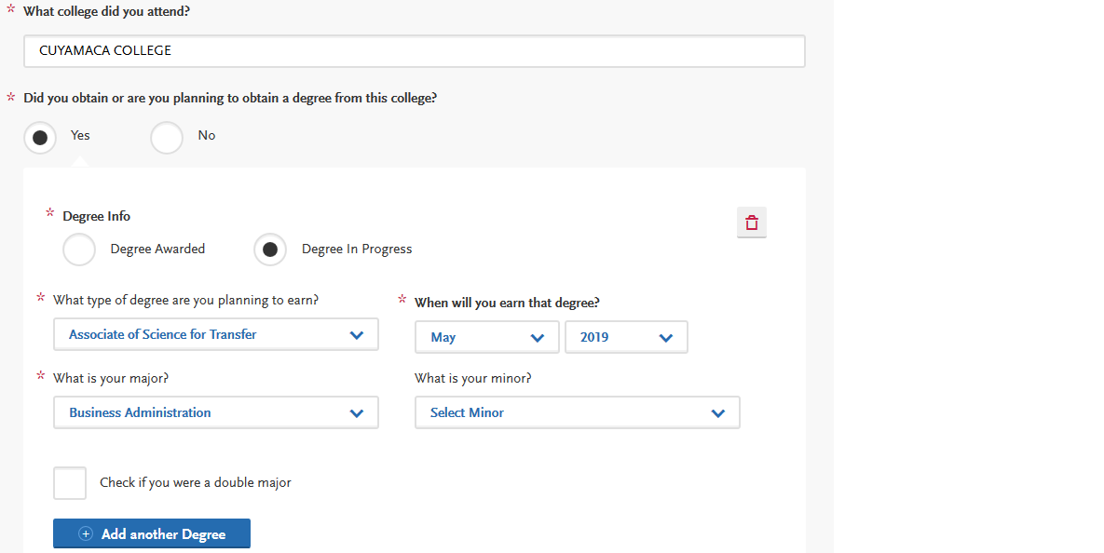
Academic History-Colleges Attended
Identify whether or not you completed or will complete an associate degree or other degree prior to transfer. If Yes, degree information is asked.
ADT applicants select either an Associate of Arts for Transfer or Associate of Science for Transfer and the major.
Identify first and last terms attended.
Continue to add a new college if you have attended more than one. All colleges you have attended must be entered.
Notes:
In this tile you will add all colleges attended and for each entry the degree awarded or in progress, type of term system, and dates of attendance. Include international post-secondary institutions and U.S. institutions you attended that are not regionally accredited.
If you are not obtaining an ADT, select “no” for degree awarded/in progress

Slide 14
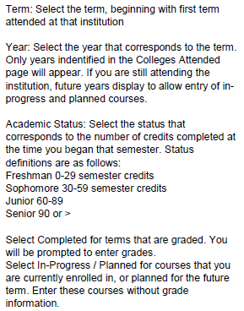
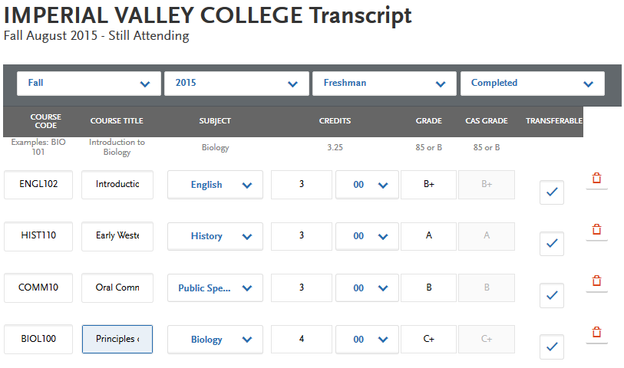
Academic History-Transcript Entry
Notes:
Undergraduate degree applicants are required to enter all college coursework based on transcript information as it appears on the transcript. Transcript entry for foreign institutions is not required. In the Transcript Entry tile select Start to begin course entry for a college.
Expanded reference file of transferable courses from ASSIST--ASSIST data is from 2016-17; newer courses will have to be manually entered.

Slide 15
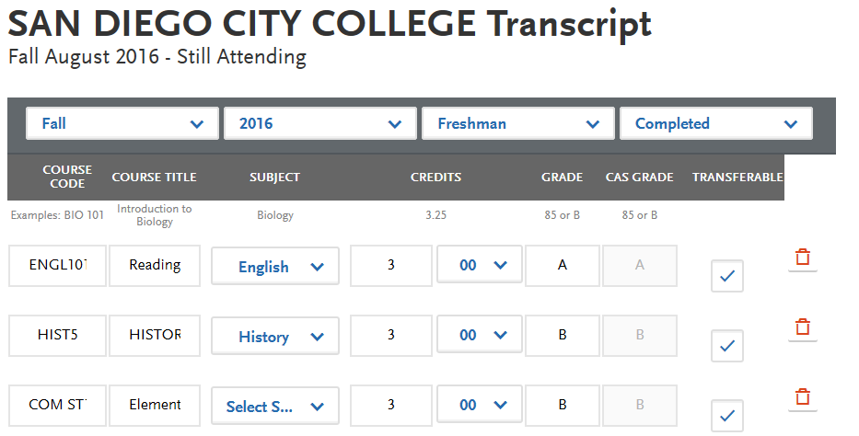
Academic History-Transcript Entry
SUBJECT: Select the subject area. In most cases it is the same as the course subject code. This field does not default with a value at this time. Make sure to select a subject for each course line. The system will not let you save the page without a subject identified for each course. If there is no corresponding subject select Special Topics.
In the COM ST11 Elements of Public Speaking example, the subject area could be either Communications or Public Speaking. The preferred subject selection is Public Speaking.
The recommendation is to select the more specific subject if available.
Notes:
Subject does not really matter for SDSU--Really none of the transcript entry sections matter, but are required. Just have student’s choose what makes the most sense. Supplemental App will ask for details.

Slide 17
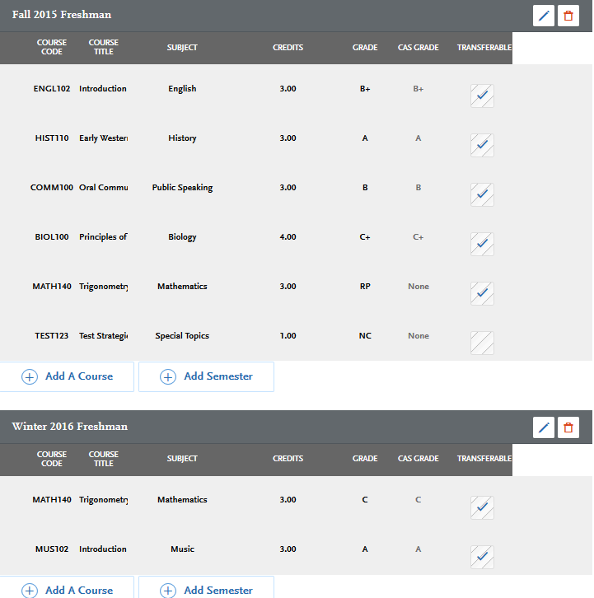
Enter repeated courses noted on the transcript with a grade of RP and academic renewal as AR.
Enter in the grade as listed on your transcript. All attempts and grades should be included.
California Community College students can use ASSIST.org or SDSU.edu/TAP to view CSU transferability.
Course numbering system on the back of the transcript or in course catalog often indicates college level, bachelor degree applicable courses.
Make sure to select a subject for each course line. If there is no corresponding subject select Special Topics.
Notes:
courses should be marked repeated only if repeated at the same institution. If you took a course at one institution and later repeated it at another institution, it should not be marked repeated. Withdrawn courses and courses taken multiple times for new credit (such as physical education courses) are also not considered repeated.
Repeat coursework example: CHEM 10 was repeated for a higher grade. Both attempts are listed but the attempt with the replaced grade was entered with RP.

Slide 18
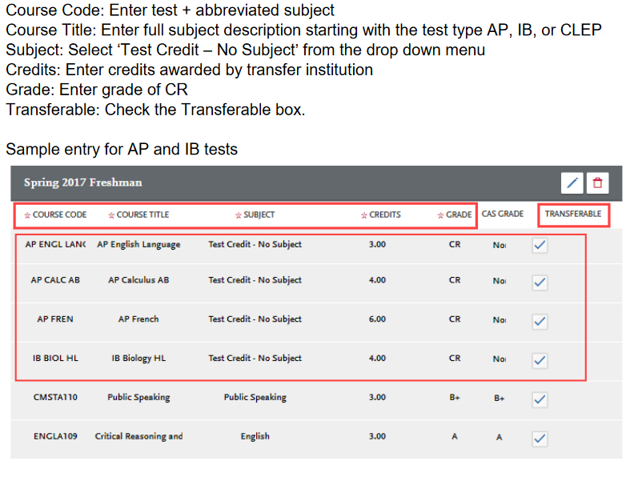
Academic History-Transcript Entry
Test Credit and CSU GE
Credit awarded for AP and IB exams noted on the primary college transcript that is used to fulfill one or more of the four required General Education subjects is entered as coursework. This allows the credit to be assigned to GE categories where eligible. Only enter credit awarded from exams at your transfer institution. Add test credit to first term of attendance.
Notes:
Enter AP scores using the proper subject of “Test Credit-No Subject”, will allow the grade to not be counted in the transferable GPA. List passing AP scores as CR. This information is also in the Instruction and FAQs within the application. --April Grommo, Ed.D.
Director of Enrollment Management Services; California State University Office of the Chancellor

Slide 19
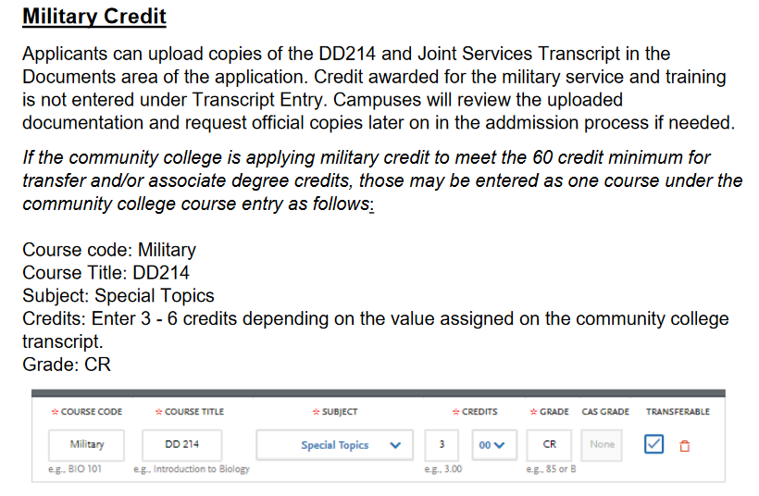

Slide 20
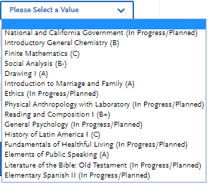
Academic History-General Education
Notes:
The courses may auto-populate based on information listed in Transcript Entry. For those that don’t, you’ll have to select from the drop-down menu which course you inputted fulfills the General Ed categories.
The dropdown selection of courses includes course titles for all courses with letter grades of C or higher. Select course that meets the GE subject category. Use ASSIST.org/TAP or GE category notations on transcript for help matching California community college courses.
Transfer applicants must complete transferable courses with a letter grade of “C” or higher in the four GE categories listed. Do not select I am not adding any General Education Courses. Do not leave one or more Subject areas incomplete.

Slide 21
Supporting Information-ADT

Slide 22
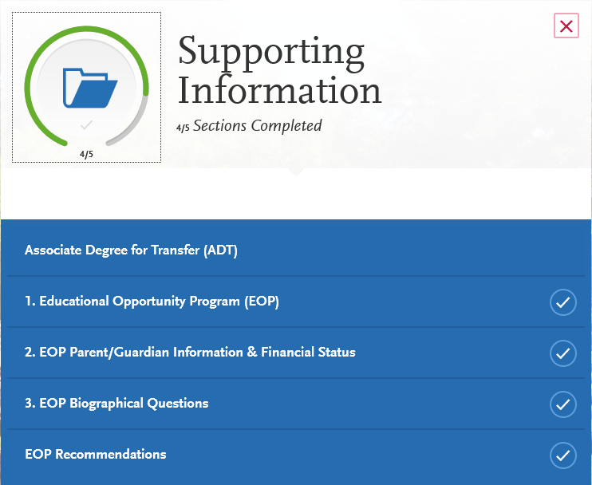
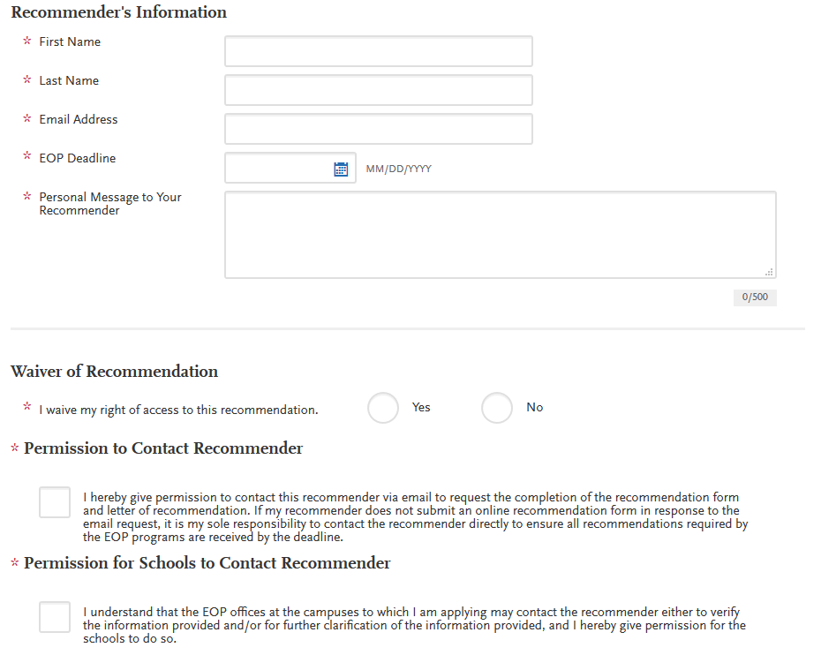
Supporting Information-EOP Application

Slide 23
EOP Application
Notes:
Priority Application deadline ends on Nov. 30th at the same time as university application. Last year student’s had to call in to Cal State Apply to re-open the application to complete EOP after Nov. 30th. We’re hoping that’s not the case and the student can go in and complete by January 15th. ALL ITEMS need to be submitted by Jan. 15th. The most important item othe rthan the application is FAFSA. Students will need to submit FAFSA by January 5th in order to receive program consideration.

Slide 24
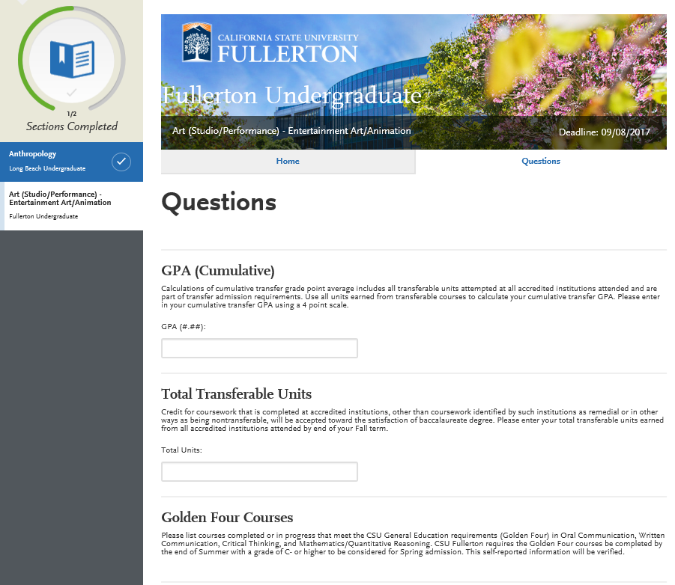
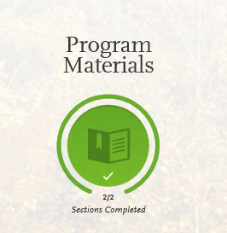
Program
Materials
Notes:
Specific programs or schools will have additional questions asked (Supplemental Application) under Program Materials. Most of them are asking about the student’s GPA, units, and Golden Four Courses. Those that don’t have questions will just have the CSU school’s information.

Slide 25
Submitting Application
Application fee waivers Fee waivers are automatically generated based on the information provided in the application. You must fully complete the application before the fee waiver eligibility is determined. Select the “Check My Fee Waivers” link to view eligibility.

Slide 26
SDSU: Transfer Admission Guarantee (TAG) for Local Students
You are in SDSU’s service area if 100% of your coursework has been completed at one or more of the following colleges:
Cuyamaca College San Diego Miramar College
Grossmont College San Diego City College
Southwestern College San Diego Mesa College
Imperial Valley College
100% of major-prep courses must be completed by Spring
Even if Cuyamaca doesn’t offer the course, you must complete it at another local community college or through Cross Enrollment
Majors excluded from TAG:
School of Nursing, Music and Dance, or Television, Film and New Media, Theater Arts (Performance) and Bachelor of Vocational Education, Athletic Training, Social Work.
All ADT Majors
Must have 2.4 GPA or GPA of the major, whichever is higher

Slide 27
CSUSM Admission Criteria
Tier 1: Completed ADT in similar major from a local admissions area college (Palomar, Miracosta, MSJC)
Tier 2: 12 units at a local admissions area school (Palomar, MiraCosta, MSJC) in last semester (or last year if part-time as long as student has not attended a non-local campus)
Tier 3: ADT in similar major earned at a non-local admissions area college (Region X schools would have priority over schools from outside San Diego)
Tier 4: Completed CSU GE or IGETC (with Oral Comm) certification and major prep completed in the local admissions area (Palomar, Miracosta, MSJC)
Tier 5: Completed CSU GE or IGETC (with Oral Comm) certification and major prep completed at a non-local admission area college (Region X schools would have priority over schools outside of San Diego)

Slide 28
SDSU Veterans
Holly Shaffner
(619) 594-0834
hshaffner@sdsu.edu

Slide 29
CSUSM Veterans
CSUSM does not hold the local criteria for admission to Veteran students.
CSUSM admits Veteran students to Fall and Spring terms.

Slide 30
SDSU Supplemental Application
Within one to five working days after submitting your initial application, you will receive a Red ID. You must use your Red ID to activate your WebPortal account.
Due: January
Update your self-reported grade point average
Verify the number of units you will complete by end of Spring
Indicate if you have completed or will complete Golden 4 classes with grades of C- or better
Indicate if you completed or will complete the preparation for the major courses
Indicate if you will be receiving an ADT
Submit online through SDSU WebPortal
www.sdsu.edu/portal
Transfer Center offers Supplemental Application workshops in January
Print yourself a copy of the Supplemental Application!!!

Slide 31
Transcripts
Read carefully when each transfer school requests transcripts
When the time is right, you must request transcripts from each college you attended
AP scores must also be requested
www.collegeboard.com

Slide 32
SDSU & CSUSM: Important Dates
January
SDSU Supplemental Application Due
February 15
CSUSM: official transcripts must be received from all colleges attended
March
Admissions decisions sent (ADT applicants will be notified after March 15)
MAY 1
Official transcripts (SDSU)
Student intent to register (SDSU & CSUSM)
$400 non-refundable fee (SDSU)
$150 non-refundable fee (CSUSM)
Final Transcripts with Spring grades:
For SDSU: June 30
For CSUSM: July 15

Slide 33
Important Next Steps
Meet with a Counselor if not sure which courses remaining to transfer
Submit your Cal Apply application by November 30
For SDSU students: complete SDSU Supplemental Application by January 22 SDSU Supplemental Application is on SDSU WebPortal
For all other CSUs: update your Cal Apply application by January 31
For CSUSM: submit transcripts by February 15
Apply for IGETC certification by June 1
If applicable, apply for ADT degree by February 13
Apply for non-ADT Associate degree, see a Counselor to learn more

Slide 34
Cuyamaca Transfer Center
Transfer Survey
https://docs.google.com/forms/d/e/1FAIpQLSdzXtwmV0SSz1w-_1bnRfQbStaVnMA4TTg5CfgBzZu8TAa5Jw/viewform
Follow us on Instagram: @CuyamacaTransferCenter

